Slide 1

Develop and Evaluate a Transferable Model Predictive Control Based Group Occupant-Centric Control Strategy
May 21, 2025
Yicheng Li

Slide 2




Acknowledgments
Financial Support:
U.S. Department of Energy via grant EE-0009153 (Hardware-in-the-loop Laboratory Performance Verification of Flexible Building Equipment in a Typical Commercial Building)
Committee Members:
Jin Wen, PhD. (Drexel University)
James Lo, PhD. (Drexel University)
Simi Hoque, PhD. (Drexel University)
Zhelun Chen, PhD. (Daikin Comfort)
Amanda Pertzborn, PhD. (National Institute of Standards and Technology)

Slide 3
Outline
Introduction
Research Objectives
Research Contents
Task 1: Virtual Testbed Development
Task 2: Predictive Model Development
Task 3: Transfer Learning Used in Group Occupant Thermal Comfort Model
Task 4: Development of MPC-based Group Occupant Centric Control
Conclusions and Future Works

Slide 4
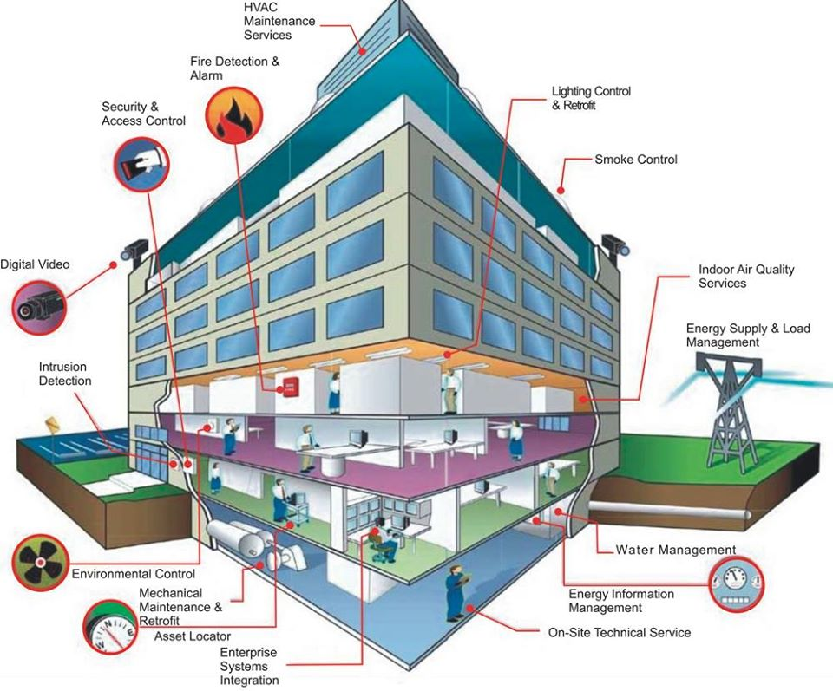

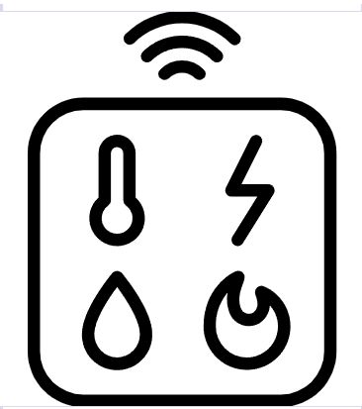




Introduction
People spend an average of 87% of their time indoors [1]
Indoor environmental quality (IEQ) issues can have a direct impact on occupant comfort, health and productivity
Sensing
Building
Building automation system
Traditional building system
Predefined schedule
Standardized comfort demand
Over-conditioning and waste of energy
Does not guarantee the comfort need of specific group of occupants
Technological progress
Prediction
Control
MPC-based Occupant-Centric Control (OCC)
Machine Learning
[1] Klepeis, N.E., et al., The National Human Activity Pattern Survey (NHAPS): a resource for assessing exposure to environmental pollutants. Journal of Exposure Science & Environmental Epidemiology, 2011. 11(3): p. 231-252.

Slide 5



Research Gaps
The development of MPC-based OCC requires a comprehensive testbed, including occupants, HVAC system, and the building
Data support
Control evaluation
In reviewed OCC studies
Experiment study: involve real occupant in a real building or conditioning chamber
Non-repeatable
Simulation study: use simulated HVAC system and occupant models
Not publicly available
Occupant
HVAC system
Building
Key components needed in testbed
Gap 1: Not publicly available testbed to support the development of MPC-based OCC strategy

Slide 6
Research Gaps
In the prediction process, there are several predictive models
One of them is occupant thermal comfort model
Sensing
Building
Typical thermal comfort model
Used for general population, such as PMV
Deviated when used for specific occupants
Emerging thermal comfort models
Individual thermal comfort model
Lead to comfort conflict in group occupants
Prediction
Control
Gap 2: Lack of thermal comfort model for a specific groups of occupants
The general framework of OCC

Slide 7
Research Gaps
In predictive model training, the occupant data collection is time-consuming
Occupant work interruption
Sensor fail
Due to the difference between occupant, one occupant thermal comfort model is different with another occupant thermal comfort model
Sensing
Building
Prediction
Control
Gap 3: Difficulty in collecting sufficient data to develop a thermal comfort model for a specific group of occupants
The general framework of OCC

Slide 8
Research Gaps
The MPC optimizes building system control to
Improve occupant thermal comfort
Reduce energy consumption
The development of MPC-based OCC is challenging, especially when considering
A specific group of occupants
The performance of the MPC-based OCC needs to be systematically evaluated
Sensing
Building
Prediction
Control
The general framework of OCC
Gap 4: Lack of a systematic framework for MPC-based group OCC development and evaluation

Slide 9
Research Objectives
Gap 1
Objective 1
No testbed
Develop a virtual testbed covering HVAC system, building, and the occupant components
Gap 2
Objective 2
Comfort conflict
Transferable MPC-based Group OCC
(TMPC-GOCC)
Develop a group occupant thermal comfort prediction model
Gap 3
Objective 3
Develop transfer learning method used for group occupant thermal comfort model
Insufficient data
Gap 4
Objective 4
MPC-based group OCC
Develop and evaluate a transferable MPC-based group OCC strategy

Slide 10
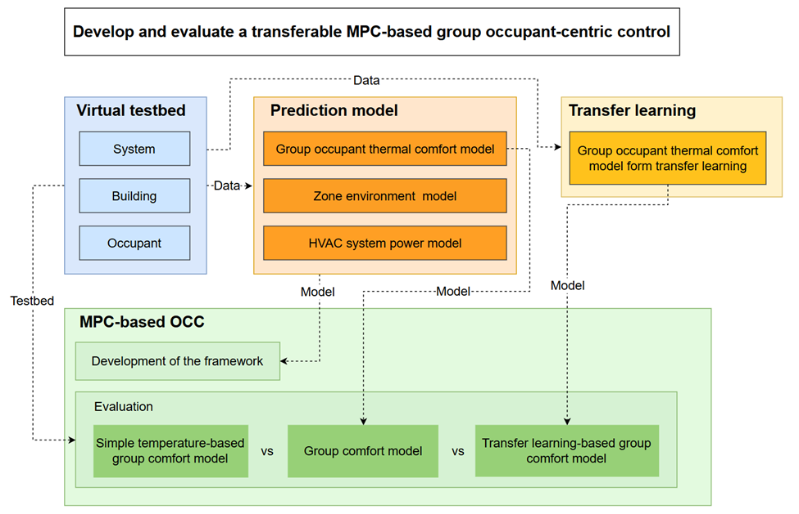
Overview of the Research
Objective 1
Objective 2
Objective 3
Objective 4

Slide 11
Objective 1: Virtual Testbed Development
(Presented in thesis proposal)
Task 1.1 HVAC System Model
Task 1.2 Zone Model
Task 1.3 Occupant Thermal Comfort Model

Slide 12
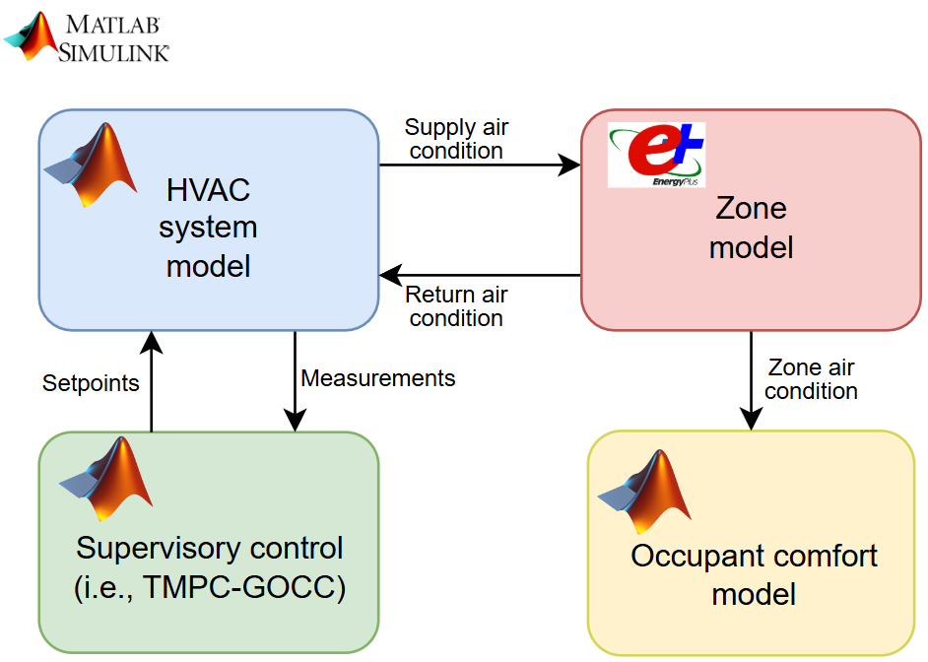
Overall Virtual Testbed Framework
The virtual testbed framework include:
HVAC system model
Zone model
Occupant comfort model
Supervisory control
Virtual testbed framework

Slide 13
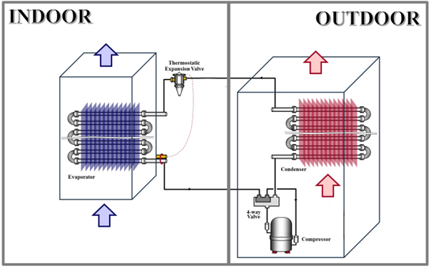
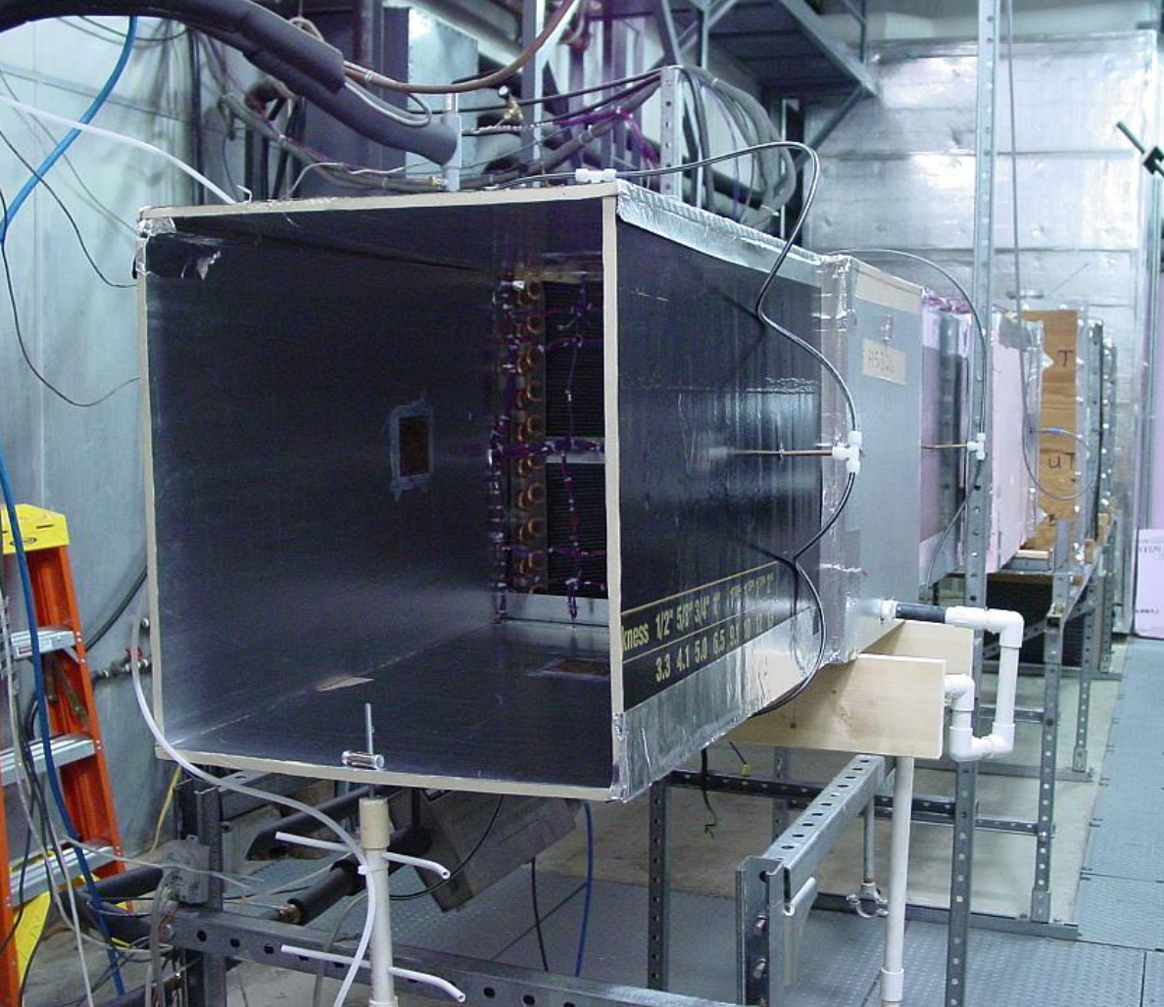
Overall Virtual Testbed Framework
Task 1.1 HVAC System Model
A two-stage Air Source Heat Pump (ASHP) at National Institute of Standards and Technology [1]
Virtual testbed framework
[1] Payne, W.V., S.H. Yoon, and P.A. Domanski, Heating mode performance measurements for a residential heat pump with single-faults imposed. 2017: US Department of Commerce, National Institute of Standards and Technology.

Slide 14
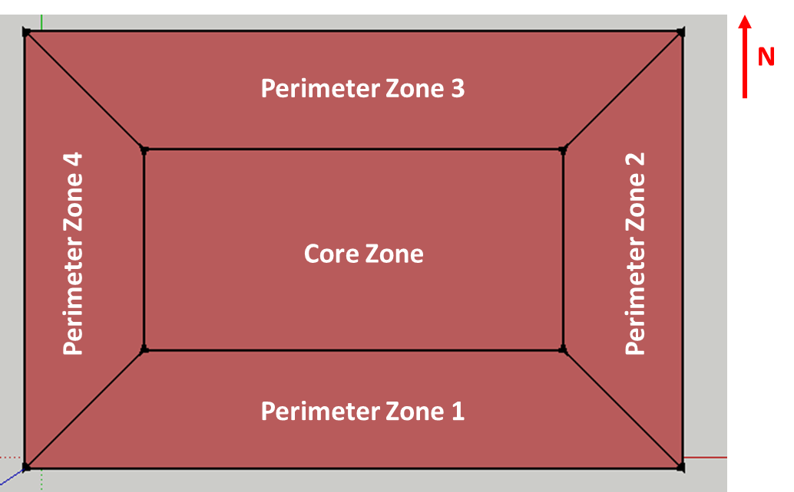
Overall Virtual Testbed Framework
Task 1.2 Zone Model
A typical small office EnergyPlus model from the Commercial Prototype Building Models [1]
Virtual testbed framework
[1] U. S. DOE. Commercial Prototype Building Models. Available: https://www.energycodes.gov/development/commercial/prototype_models

Slide 15
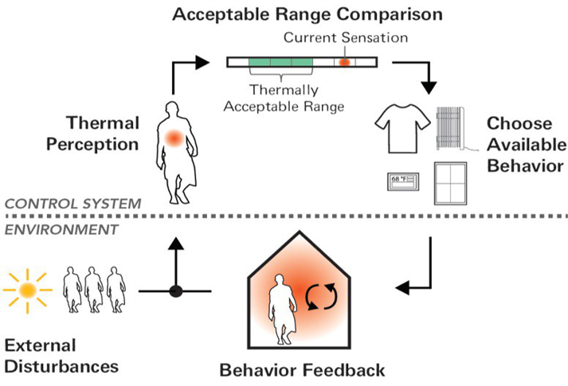
Overall Virtual Testbed Framework
Task 1.3 Occupant Thermal Comfort Model
Adapted from an agent-based occupant’s thermal comfort and behaviors model [1]
Simulate occupant thermal comfort only
Virtual testbed framework
[1] Langevin, J., J. Wen, and P.L. Gurian, Modeling thermal comfort holistically: Bayesian estimation of thermal sensation, acceptability, and preference distributions for office building occupants. Building and Environment, 2013. 69: p. 206-226

Slide 16
Conclusions of Objective 1
Objective 1: Virtual Testbed Development
A virtual testbed is developed, which uses ASHP to serve a single zone in small office with virtual occupants
The testbed is used to generate the datasets for the development of predictive model, transfer learning method, and the TMPC-GOCC strategy

Slide 17
Objective 2: Predictive Model Development
Task 2.1 Group Occupant Thermal Comfort Model Development
(Presented in thesis proposal)
Task 2.2 Zone Environment and HVAC System Power Model Development

Slide 18
Task 2.1 Group Thermal Comfort Model Development
Challenge
Comfort conflict in groups of occupants
Solution
Develop an indicator to represent the thermal comfort of a group, and optimize it to reduce comfort conflict
Definition of group thermal comfort using inclusive and homogeneous methods
Inclusive: Everyone's opinion can be reflected in the results
Homogeneous: All group members are equally important
Definition: A number of the occupants within the group who feel comfortable
The group thermal comfort could be flexibly adjusted
For example, if considering the needs of the vulnerable, more weight can be given
$${Group}_{Comf}=\#{Occ}_{comfortable}$$

Slide 19
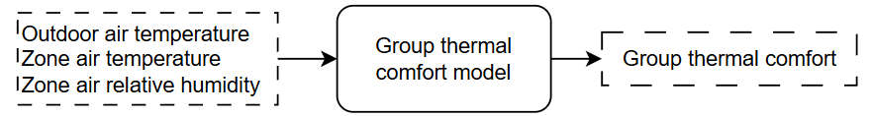

Task 2.1 Group Thermal Comfort Model Development
Methodology of the group thermal comfort model development and evaluation
Raw data
Obtained from a hardware-in-the-loop load flexibility study [1]
Include the occupant thermal comfort votes with HVAC system and environment measurement
Feature selection
Based on the literature review, three commonly available features are selected
Model type determination
Classification model (the number of occupants is an integer, discrete number)
Candidate model structure
Artificial Neural Networks (ANN)
Support Vector Machines (SVM)
Random Forest (RF)
k-Nearest Neighbor (kNN)
$$\#{Occ}_{comfortable}$$
[1] Jin Wen, Z.C., et al., (2023), Hardware-in-the-loop Laboratory Performance Verification of Flexible Building Equipment in a Typical Commercial Building: Performance of Heating, Ventilation, and Air Conditioning and Thermal Energy Storage Across the United States, National Institute of Standards and Technology, https://doi.org/10.18434/mds2-3058

Slide 20
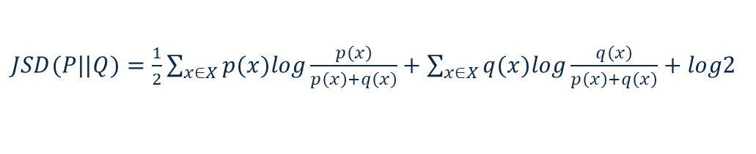
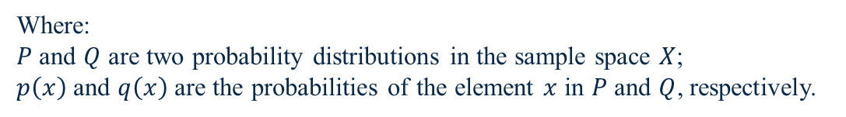
Task 2.1 Group Thermal Comfort Model Development
Methodology of the group thermal comfort model evaluation
Typical index:
Instance-based accuracy
Fail to capture the stochastic nature of occupant thermal comfort
Proposed index:
Similarity measures, which uses Jensen–Shannon divergence (JSD) to evaluate the difference of the two distributions [1]
$JSD(P||Q)=\frac{1}{2}\sum_{x∈X}{p(x)log\frac{p\left(x\right)}{p\left(x\right)+q\left(x\right)}}+\sum_{x∈X}{q(x)log\frac{q\left(x\right)}{p\left(x\right)+q\left(x\right)}}+log2$
Where:
$P$ and $Q$ are two probability distributions in the sample space $X$;
$p\left(x\right)$ and $q\left(x\right)$ are the probabilities of the element $x$ in $P$ and $Q$, respectively.
An example of JSD=0.044
An example of JSD=0.320
[1] Menéndez M L, Pardo J A, Pardo L, et al. The jensen-shannon divergence[J]. Journal of the Franklin Institute, 1997, 334(2): 307-318.

Slide 21
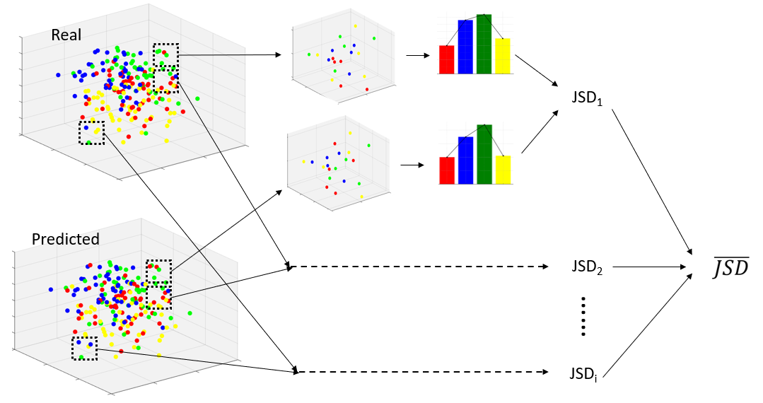
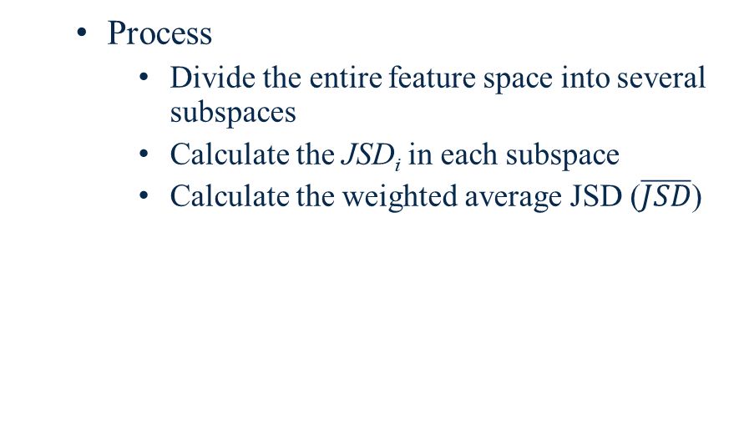

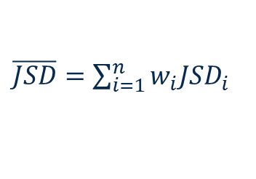
Task 2.1 Group Thermal Comfort Model Development
Methodology of the group thermal comfort model evaluation
Process
Divide the entire feature space into several subspaces
Calculate the JSD_{i} in each subspace
Calculate the weighted average JSD ($\overline{JSD}$)
$\overline{JSD}=\sum_{i=1}^{n}{w_{i}JSD_{i}}$
$$w_{i}=\frac{n_{i}}{n_{total}}$$
Weighted mean JSD calculation schema

Slide 22
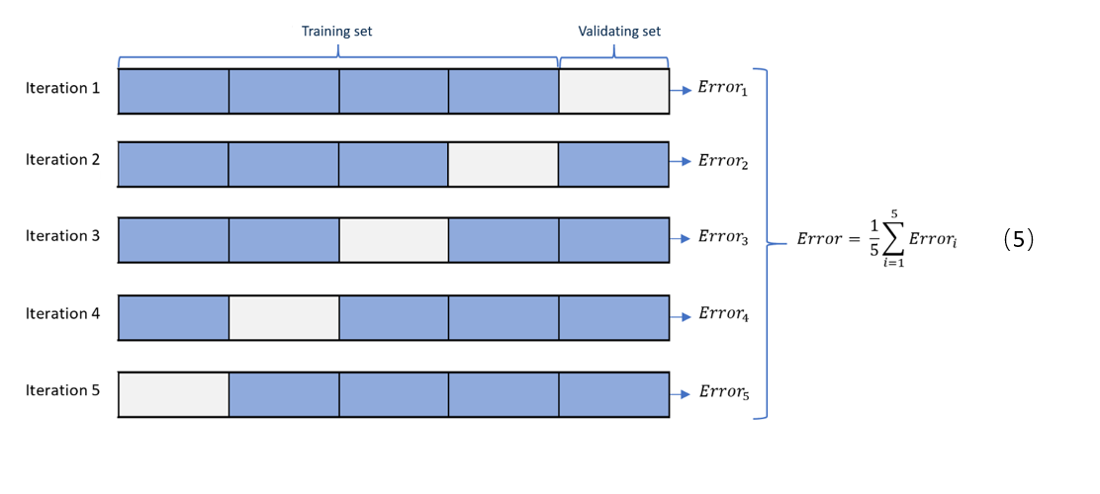
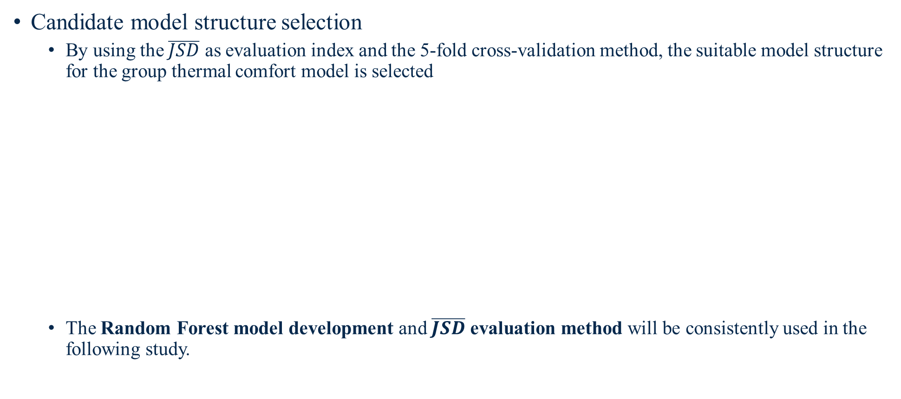
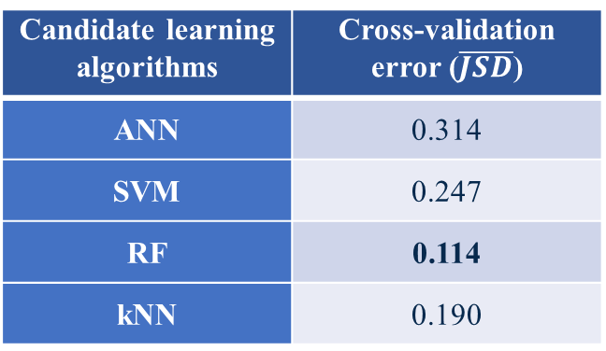
Task 2.1 Group Thermal Comfort Model Development
Candidate model structure selection
By using the $\overline{JSD}$ as evaluation index and the 5-fold cross-validation method, the suitable model structure for the group thermal comfort model is selected
The Random Forest model development and $\overline{JSD}$ evaluation method will be consistently used in the following study.
Candidate learning algorithms | Cross-validation error ($\overline{JSD}$)
ANN | 0.314
SVM | 0.247
RF | 0.114
kNN | 0.190
5-fold cross-validation schema
Cross-validation results

Slide 23
Task 2.2 Zone Environment and HVAC System Power Model Development
Goal:
Develop three models to predict zone air temperature, zone air relative humidity, and HVAC system power in the future time (prediction timestep = 15 min), respectively
Data generation
Use the developed virtual testbed (Atlanta Summer) to generate the model training and validation data
Training data
Use active learning [1] to generate the zone air temperature setpoint (65℉ ~ 85℉)
Simulation period: 2 days
Validation data
Randomly generate the zone air temperature setpoint (65℉ ~ 85℉)
Simulation period: 1day
[1] Zhang, L. and J. Wen, A systematic feature selection procedure for short-term data-driven building energy forecasting model development. Energy and Buildings, 2019. 183: p. 428-442

Slide 24
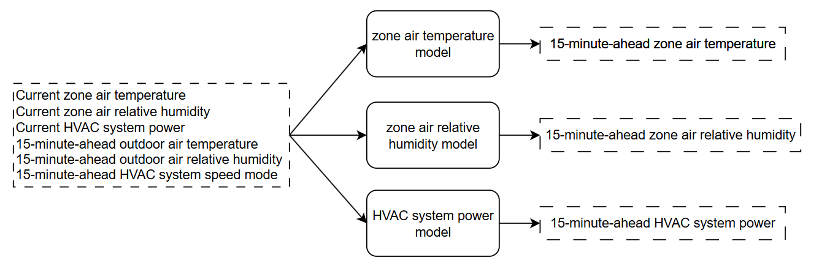
Task 2.2 Zone Environment and HVAC System Power Model Development
Feature selection
Based on the literature, manually select the commonly available features:
Candidate model structures
Artificial Neural Network (ANN)
Recurrent Neural Network (RNN)
Multiple Linear Regression (MLR)
Multivariate Adaptive Regression Splines (MARS)

Slide 25
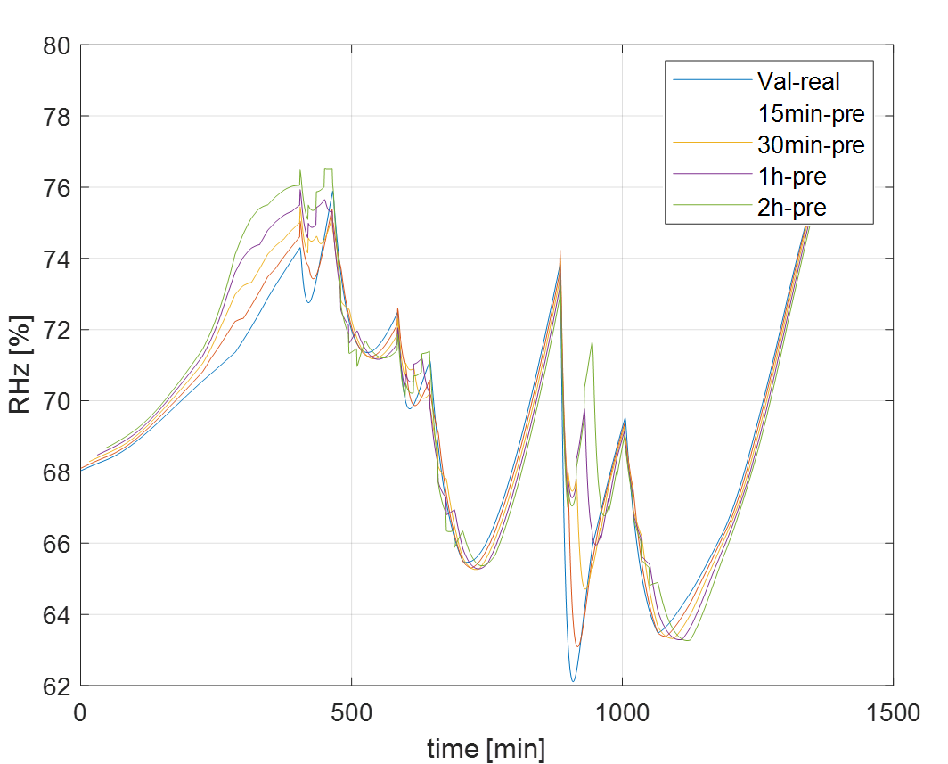
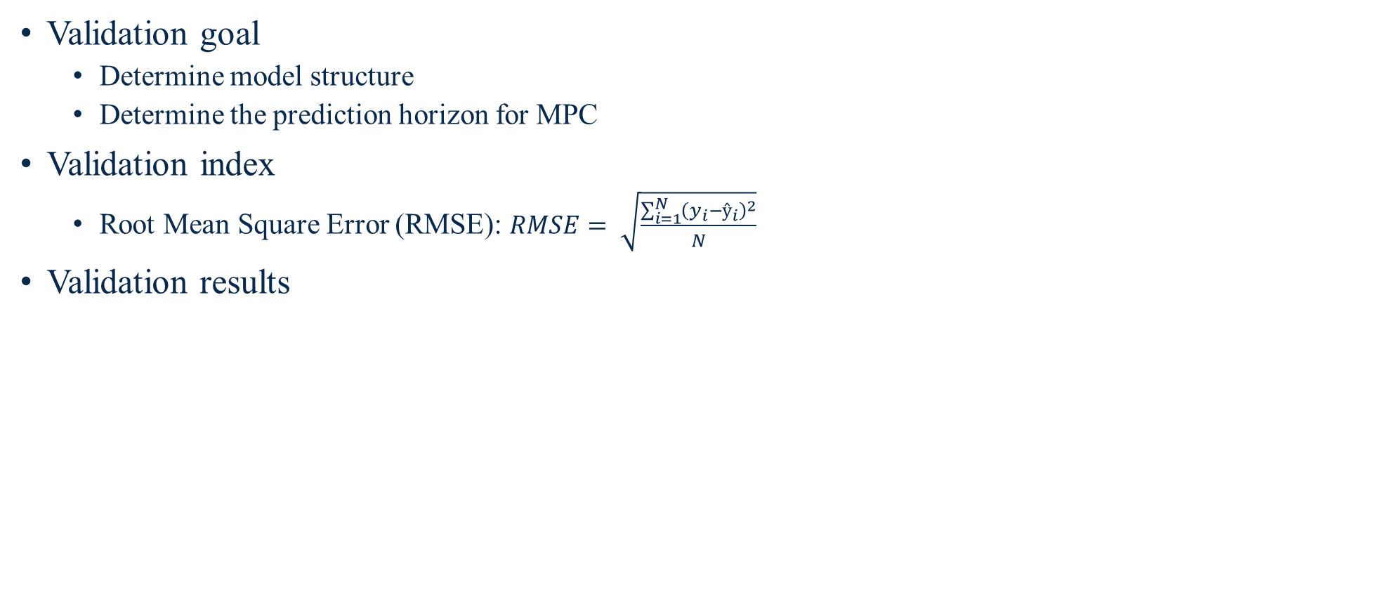
Task 2.2 Zone Environment and HVAC System Power Model Development
Validation goal
Determine model structure
Determine the prediction horizon for MPC
Validation index
Root Mean Square Error (RMSE): $RMSE= \sqrt{\frac{\sum_{i=1}^{N}{{\left(y_{i}−ŷ_{i}\right)}^{2}}}{N}}$
Validation results
Candidate learning algorithms | Candidate Prediction Horizons (PH)
 | ph=1 | ph=2 | ph=4 | ph=8
ANN | 1.48 | 3.26 | 5.73 | 8.59
RNN | 3.47 | 5.82 | 8.36 | 11.09
MLR | 5.63 | 9.27 | 13.58 | 18.94
MARS | 1.51 | 2.74 | 4.74 | 8.12
Zone air relative humidity MARS model validation results
Summary of validation error [%] in zone air relative humidity model

Slide 26
Task 2.2 Zone Environment and HVAC System Power Model Development
Validation results
Model structures selection and error
Zone air temperature RNN model: 0.21 °C
Zone air relative humidity MARS model: 4.74%
HVAC system power ANN model: 71W
Prediction horizon (PH) selection
PH=4, based on the typical criteria (0.5 °C for temperature, 5% for relative humidity, and 90W for HVAC system power [1])
[1] American Society of Heating, V., and Air Conditioning Engineers (ASHRAE), Guideline 14-2014, in Measurement of Energy and Demand Savings. 2014.

Slide 27
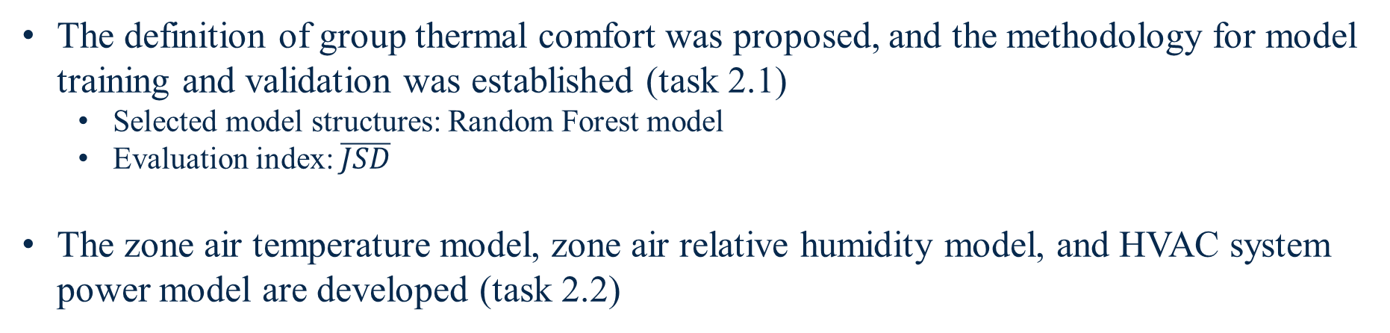
Conclusions of Objective 2
Objective 2: Predictive Model Development
The definition of group thermal comfort was proposed, and the methodology for model training and validation was established (task 2.1)
Selected model structures: Random Forest model
Evaluation index: $\overline{JSD}$
The zone air temperature model, zone air relative humidity model, and HVAC system power model are developed (task 2.2)

Slide 28
Objective 3: Transfer Learning (TL) Used in Group Occupant Thermal Comfort Model
Task 3.1 TL Framework Development
(Presented in thesis proposal)
Task 3.2 Evaluation Scenarios Design
Task 3.3 Evaluation Results Analyze

Slide 29
Task 3.1 Transfer Learning Framework Development
Background
A reliable group thermal comfort model need sufficient data to train
The data collection of occupant is time-consuming
There is often a lack of data to develop the group thermal comfort model
Solution: Transfer learning
A machine learning technique that transfers previously learned knowledge to a new task [1]
A solution for insufficient data problem [2, 3]
Transfer the knowledge from source domain to target domain
[1] Pan, W., E. Xiang, and Q. Yang. Transfer learning in collaborative filtering with uncertain ratings. in Proceedings of the AAAI Conference on Artificial Intelligence. 2012.
[2] Gupta, N. and A.S. Jalal, Traditional to transfer learning progression on scene text detection and recognition: a survey. Artificial Intelligence Review, 2022: p. 1-46.
[3] Di, S., et al., Cross-domain traffic scene understanding: A dense correspondence-based transfer learning approach. IEEE transactions on intelligent transportation systems, 2017. 19(3): p. 745-757.

Slide 30
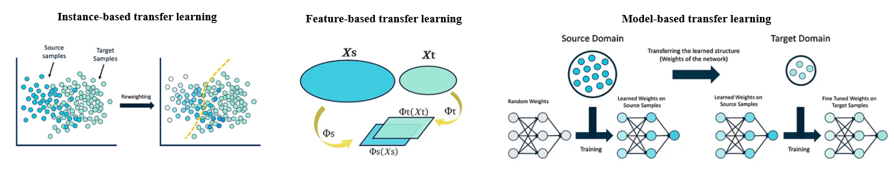
Task 3.1 Transfer Learning Framework Development
Categorization of TL
Instance-based
Transfer the knowledge by re-sampling source instances to minimize the difference in marginal distributions
This method is used in this study
Feature-based
Minimize the mismatch by transferring features to another space
This method is not used because the features of the group thermal comfort model are typical available
Model-based
Keep parts of the model from source domain, and fine-tune the model for the target domain
This method is not used because the group thermal comfort RF model is hard to fine-tune
The schema of three categories of TL [1]
[1] Asgarian, A., An Introduction to Transfer Learning, a simple and concise explanation with real examples, in Medium. 2018.

Slide 31
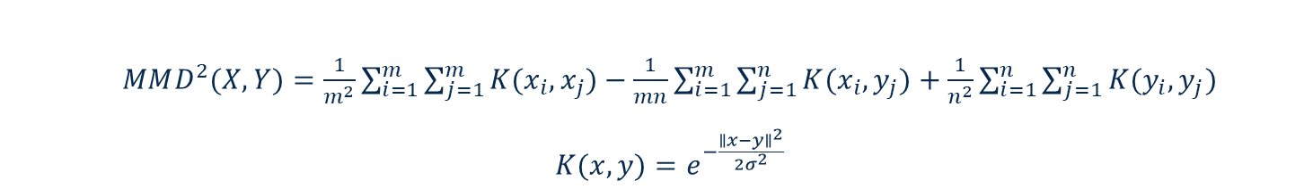

Task 3.1 Transfer Learning Framework Development
The key procedure in instance-based transfer learning is sample adaptation
Sample adaptation
Minimize the difference of marginal distributions between two domains.
The difference is measured by Maximum Mean Discrepancy (MMD) [1]
Use optimization method to minimize MMD
Objective function
Optimization algorithm: Genetic algorithm
$MMD^{2}(X,Y)=\frac{1}{m^{2}}\sum_{i=1}^{m}{\sum_{j=1}^{m}{K(x_{i},x_{j})}}−\frac{1}{mn}\sum_{i=1}^{m}{\sum_{j=1}^{n}{K(x_{i},y_{j})}}+\frac{1}{n^{2}}\sum_{i=1}^{n}{\sum_{j=1}^{n}{K(y_{i},y_{j})}}$
$K(x,y)=e^{−\frac{{∥x−y∥}^{2}}{2σ^{2}}}$
Where:
x_{i} and y_{i} is the data in two distribution X and Y, respectively
K is Gaussian kernel function
σ is the parameter in K, typically equal to 1
$$J(x)=MMD(Ds_{(x)},Dt)$$
Where:
Ds and Dt are the instances in the source and target domain
x is an indicator of the instances resampled from the source domain
[1] Xiao, D., et al., Domain adaptive motor fault diagnosis using deep transfer learning. Ieee Access, 2019. 7: p. 80937-80949

Slide 32
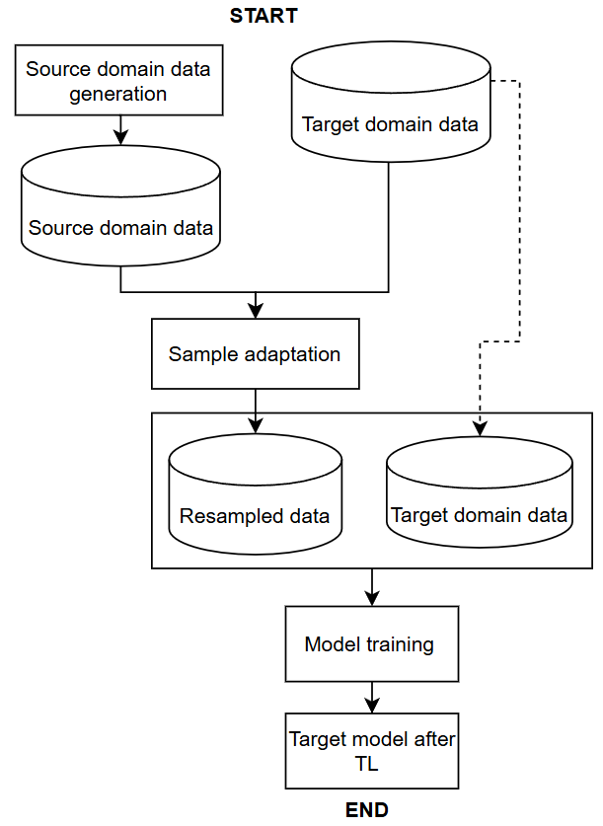
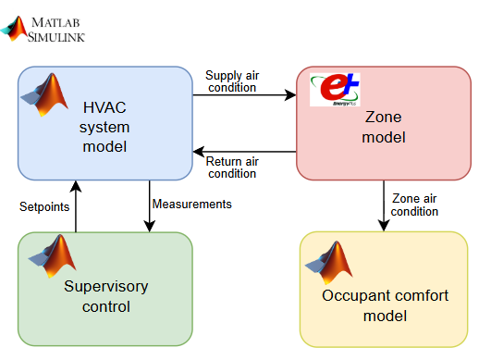

Task 3.1 Transfer Learning Framework Development
Instance-based TL
Use TL to find data from virtual testbed simulated data that is close to realistic data to enrich the training data of group thermal comfort model
Virtual testbed
Reality
Source domain
(simulated occupant data)
transfer
Target domain
(real occupant data)
Framework of model development using instance-based transfer learning

Slide 33


Task 3.2 Evaluation Scenarios Design
Source domain: virtual testbed simulation data
The source domain data includes 3 different numbers of occupant (5, 10, and 15)
Design based on the zone area and the minimum area per occupant
24 groups of each population size (thermal acceptability is sampled by RP-884)
Make sure that the source domain have enough groups with different thermal preferences
1-month simulation with random setpoint (65°F ~85°F)
5-occupants group
……
10-occupants group
24 groups
……
15-occupants group
24 groups
……
24 groups
Source domain data diagram

Slide 34

Task 3.2 Evaluation Scenarios Design
Target domain scenarios design: “real data” obtained by using virtual testbed to represent the real building
Evaluate the scenarios with different number of occupants:
Evaluate the scenarios with different group thermal preferences
5-occupants scenario
(minimum occupant size in source domain)
7-occupants scenario
(a different size not included in the source domain)
15-occupants scenario
(maximum occupant size in source domain)
Cold group thermal preference
(manually generated acceptability)
Neutral group thermal preference
(Acceptability is sampled by RP-884)
Warm group thermal preference
(manually generated acceptability)

Slide 35
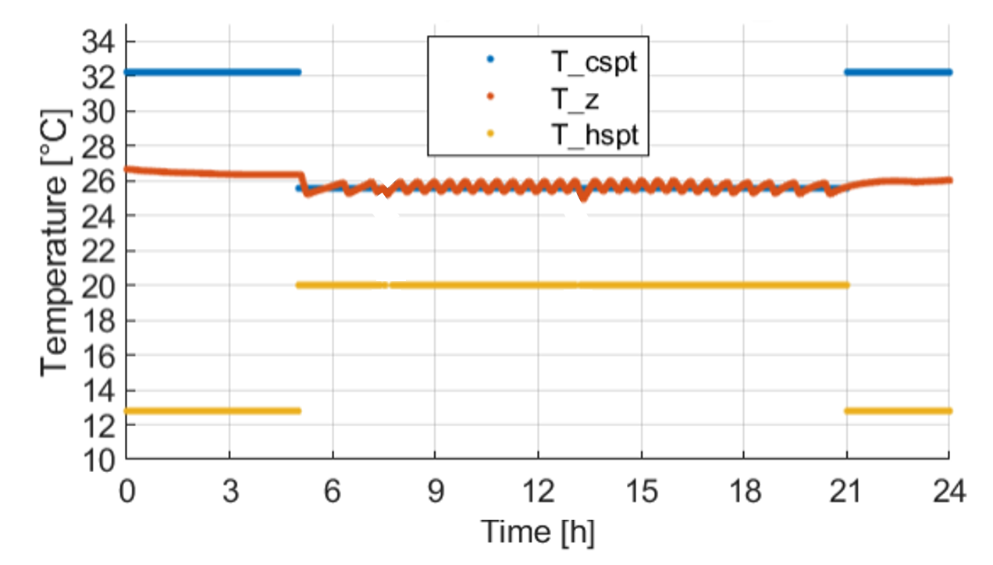
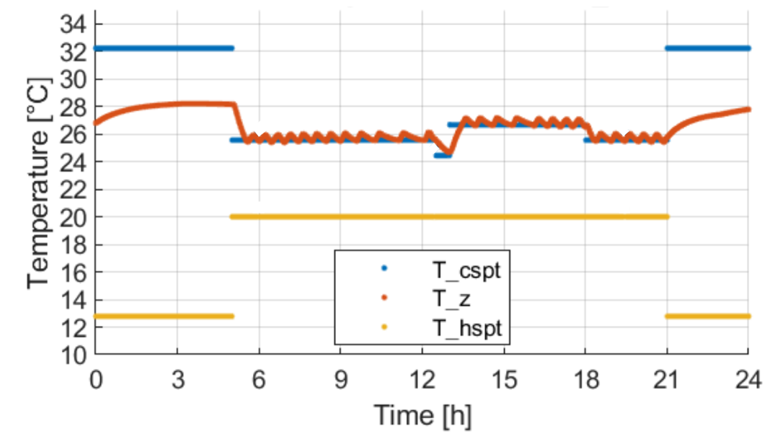
Task 3.2 Evaluation Scenarios Design
Target domain scenarios design: “real data” obtained by using virtual testbed to represent the real building
Evaluate the scenarios with different operational strategies
Evaluate the scenarios with different data collection period: 1-day, 2-days, 3-days, 4-days, and 5-days
One cooling setpoint scenario
(78℉)
Three cooling setpoints scenario
(Load shifting strategy [1]: precooling: 76 ℉; normal: 78 ℉; and peak: 80 ℉)
[1] Chen, Z., et al., Development of a Hardware-in-the-loop Testbed for Laboratory Performance Verification of Flexible Building Equipment in Typical Commercial Buildings., 2023.

Slide 36
Task 3.2 Evaluation Scenarios Design
Summary of TL evaluation scenarios design
Totally, there are 90 evaluation cases are designed.
The source domain data remains identical, while the difference is in target domain scenarios.
 | Source domain | Target domain
Location and weather | Atlanta Summer
Building and HVAC system | Virtual testbed | “Real building” represented by virtual testbed
Occupants | 24 groups of 5 occupants 24 groups of 10 occupants 24 groups of 15 occupants | 5 occupants |  | 7 occupants |  |  |  | 15 occupants
 |  | Neutral preference |  | Cold preference |  |  |  | Warm preference
HVAC operation | Random cooling setpoints | One cooling setpoint |  |  |  | Three cooling setpoints
Data collection period | 1 month | 1 day | 2 days |  | 3 days |  | 4 days |  | 5 days

Slide 37
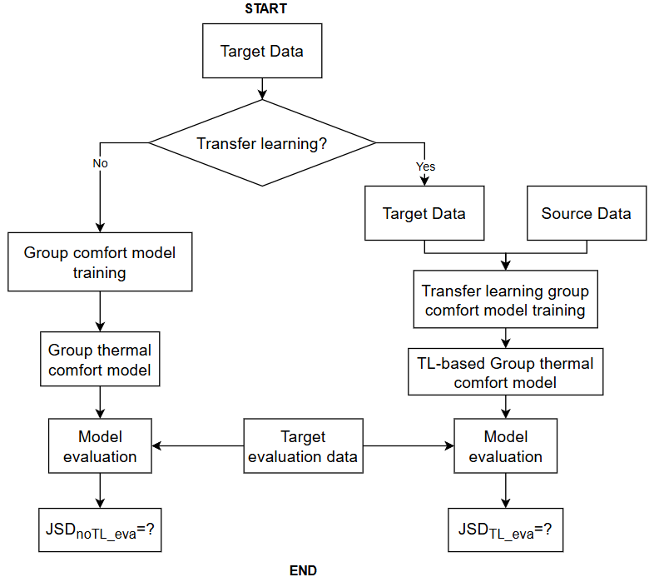
Task 3.2 Evaluation Scenarios Design
Evaluation method
Develop the group thermal comfort model with and without TL, respectively
Use target evaluation data to evaluate the model performance
Target evaluation data generation:
5-days data with random setpoint (72°F ~80°F [1])
Compare the JSD_{noTL_eva} and JSD_{TL_eva}
TL evaluation framework
[1] ANSI/ASHRAE Standard 55-2020, Thermal Environmental Conditions for Human Occupancy, 2020

Slide 38
Task 3.3 Evaluation Results Analyze
Evaluation results
Use 7-occupant scenarios as an example
Conclusion
Effectiveness of TL
TL always improves model predictive performance, regardless of group characteristics, HVAC system control strategies, or data collection periods
Demonstrates strong applicability
Impact of control strategy and data collection period on model performance
For one-setpoint control, additional data is useless
For three-setpoints control, additional data can improve model performance
→ The richness (information entropy [1]) of target domain data may impact model predictive performance and transfer learning effect
[1] Kozak, J. and P. Juszczuk, Entropy in Real-World Datasets and Its Impact on Machine Learning. 2023: MDPI-Multidisciplinary Digital Publishing Institute.

Slide 39
Task 3.3 Evaluation Results Analyze
Evaluation of the impact of information entropy on:
Model predictive performance (JSD_{noTL-eva} or JSD_{TL-eva)})
TL effect (ΔJSD = JSD_{noTL-eva} - JSD_{TL-eva)})
Conclusion
Model performance
Higher information entropy generally results in a model with lower JSD, indicating better predictive performance
TL effect
All positive impact
No significant relationship between information entropy and ΔJSD
→ TL always can enhance the model's predictive performance. However, the extent of improvement is different case by case

Slide 40
Conclusions of Objective 3
Objective 3: TL Used in Group Occupant Thermal Comfort Model
A framework of instance-based TL is developed (task 3.1)
A series of evaluation cases are designed (task 3.2), including the difference in:
Group occupant
HVAC system control strategy
Data collection period
Based on the evaluation results, TL has strong applicability in improving group thermal comfort model’s predictive performance (task 3.3)

Slide 41
Objective 4: Development and Evaluation of Transferable MPC-based Group Occupant Centric Control (TMPC-GOCC)
Task 4.1 MPC Framework Development
Task 4.2 Evaluation Cases Design
Task 4.3 Evaluation Results Analyze

Slide 42
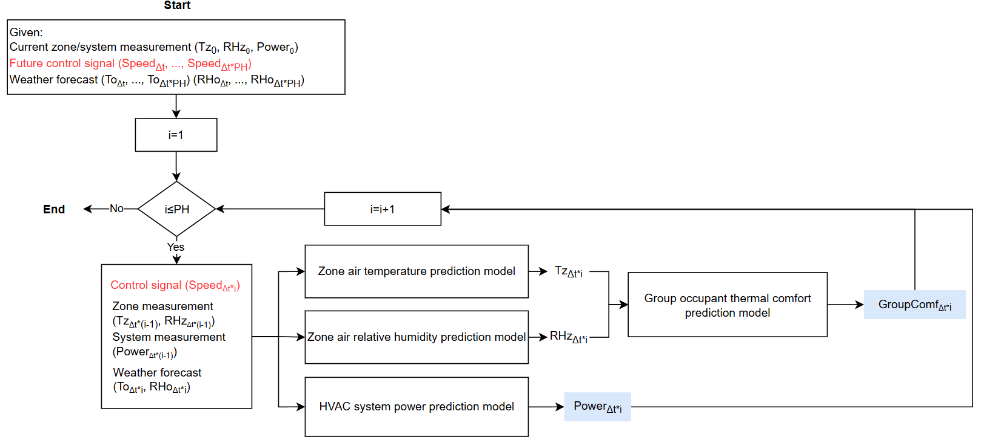
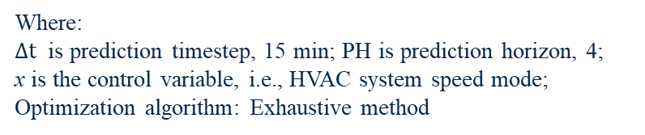

Task 4.1 MPC Framework Development
$$min⁡J\left(x\right)=\sum_{t}^{PH}{{Power}_{15∗t}}×Δt$$
Objective function:
Where:
$Δt$ is prediction timestep, 15 min; PH is prediction horizon, 4;
x is the control variable, i.e., HVAC system speed mode;
Optimization algorithm: Exhaustive method
[1] ANSI/ASHRAE Standard 55-2020, Thermal Environmental Conditions for Human Occupancy, 2020

Slide 43
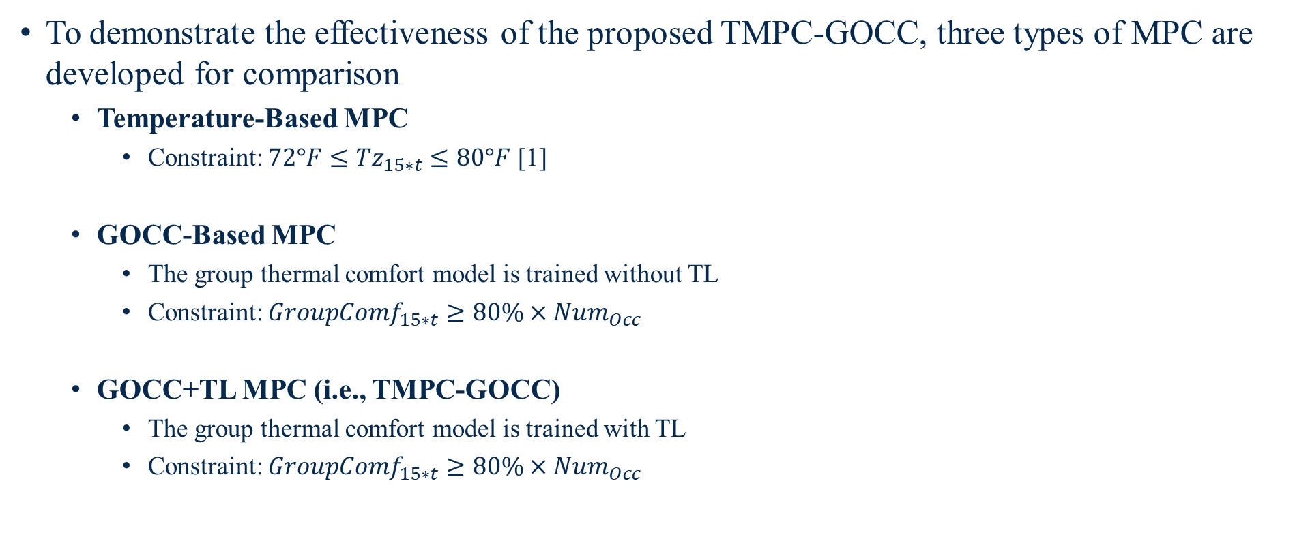
Task 4.1 MPC Framework Development
To demonstrate the effectiveness of the proposed TMPC-GOCC, three types of MPC are developed for comparison
Temperature-Based MPC
Constraint: ${72°F≤Tz}_{15∗t}≤80°F$ [1]
GOCC-Based MPC
The group thermal comfort model is trained without TL
Constraint: ${GroupComf}_{15∗t}≥80\%×{Num}_{Occ}$
GOCC+TL MPC (i.e., TMPC-GOCC)
The group thermal comfort model is trained with TL
Constraint: ${GroupComf}_{15∗t}≥80\%×{Num}_{Occ}$
[1] ANSI/ASHRAE Standard 55-2020, Thermal Environmental Conditions for Human Occupancy, 2020

Slide 44
Task 4.2 Evaluation Cases Design
Goal of evaluation:
Evaluate the control performance of three MPCs
Investigate the impact of group thermal comfort model accuracy on MPC control performance
Solution:
Based on the TL evaluation results, 10 cases (JSD_{TL-eva}< 0.3) were selected
For each evaluation case
Three types of MPC are developed
5-day simulation using virtual testbed
Compare the control performance in occupant comfort
Evaluation cases | JSD_{noTL-eva} | JSD_{TL-eva}
5occ-N-3SP-5D | 0.326 | 0.031
15occ-N-3SP-5D | 0.221 | 0.041
7occ-N-3SP-5D | 0.323 | 0.102
15occ-N-3SP-4D | 0.276 | 0.119
5occ-N-3SP-4D | 0.408 | 0.135
15occ-N-3SP-1D | 0.413 | 0.185
15occ-N-3SP-3D | 0.363 | 0.198
7occ-N-3SP-3D | 0.448 | 0.229
5occ-C-3SP-5D | 0.367 | 0.266
7occ-N-3SP-2D | 0.496 | 0.296
TMPC-GOCC evaluation cases

Slide 45
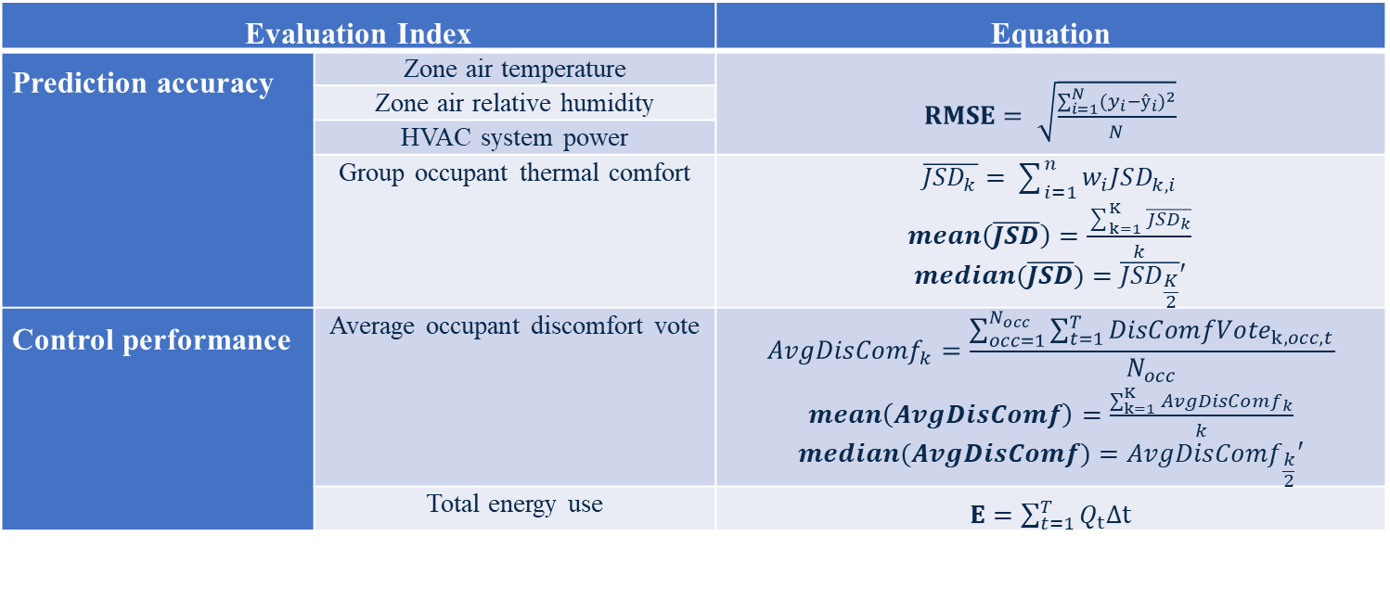
Task 4.2 Evaluation Cases Design
MPC evaluation index
Evaluation Index |  | Equation
Prediction accuracy | Zone air temperature | $RMSE= \sqrt{\frac{\sum_{i=1}^{N}{{(y_{i}−ŷ_{i})}^{2}}}{N}}$
 | Zone air relative humidity
 | HVAC system power
 | Group occupant thermal comfort | $\overline{{JSD}_{k}}=\sum_{i=1}^{n}{w_{i}JSD_{k,i}}$ $mean\left(\overline{JSD}\right)=\frac{\sum_{k=1}^{K}{\overline{{JSD}_{k}}}}{k}$ $$median(\overline{JSD})=\overline{{JSD}_{\frac{K}{2}}}′$$
Control performance | Average occupant discomfort vote | $${AvgDisComf}_{k}=\frac{\sum_{occ=1}^{N_{occ}}{\sum_{t=1}^{T}{{DisComfVote}_{k,occ,t}}}}{N_{occ}}$$ $mean\left(AvgDisComf\right)=\frac{\sum_{k=1}^{K}{{AvgDisComf}_{k}}}{k}$ $$median(AvgDisComf)={AvgDisComf}_{\frac{k}{2}}′$$
 | Total energy use | $E=\sum_{t=1}^{T}{Q_{t}∆t}$
Note: Since the stochastic nature of occupant thermal comfort, the occupant comfort model conducted 50 simulations for each evaluation case to capture the distribution of occupant thermal comfort votes. Therefore, the mean and median values of $\overline{JSD}$ and $AvgDisComf$ are calculated.

Slide 46
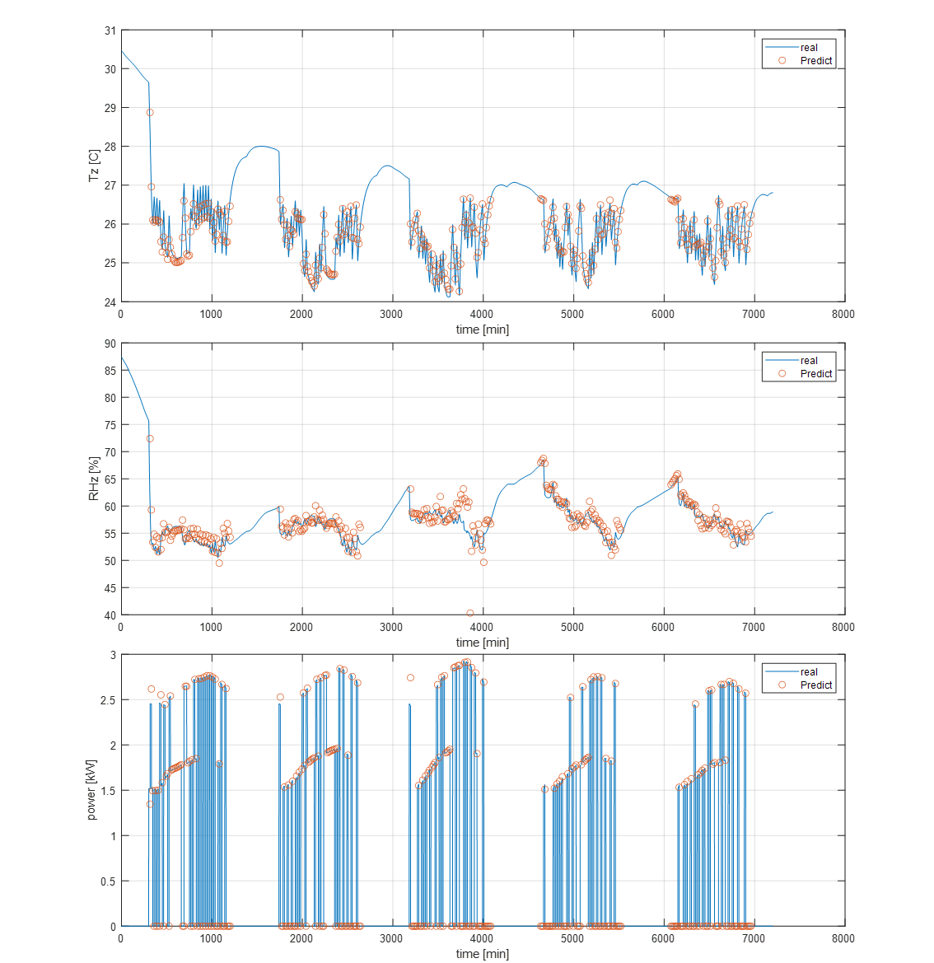
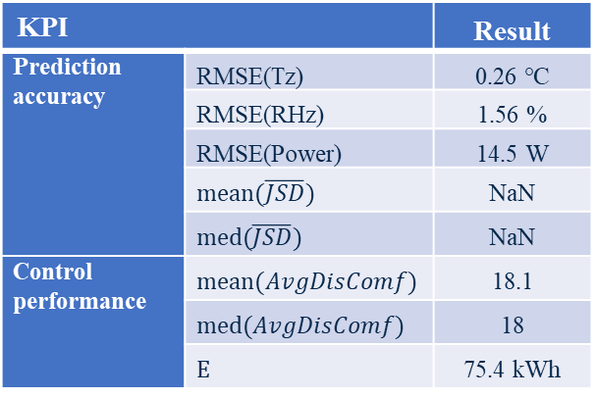
Task 4.3 Evaluation Results Analyze
The temperature-based MPC simulation results in15occ-N-3SP-4D evaluation case
Zone air temperature
HVAC system power
KPI |  | Result
Prediction accuracy | RMSE(Tz) | 0.26 ℃
 | RMSE(RHz) | 1.56 %
 | RMSE(Power) | 14.5 W
 | $$mean(\overline{JSD})$$ | NaN
 | $$med(\overline{JSD})$$ | NaN
Control performance | $$mean(AvgDisComf)$$ | 18.1
 | $$med(AvgDisComf)$$ | 18
 | $$E$$ | 75.4 kWh
Zone air relative humidity

Slide 47
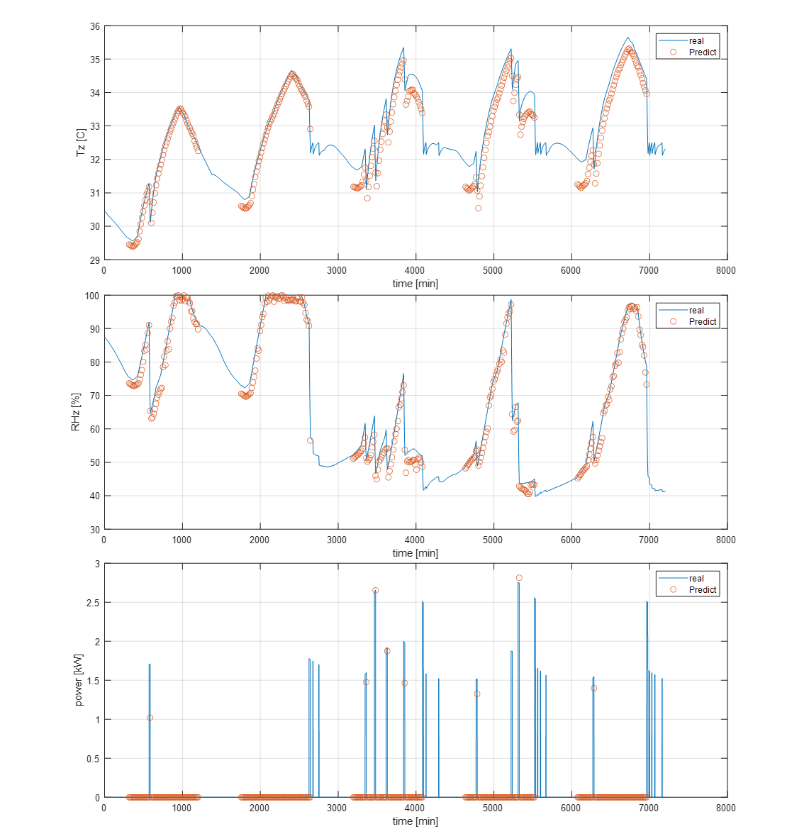
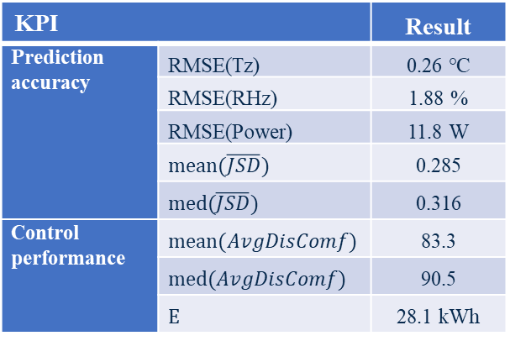
Task 4.3 Evaluation Results Analyze
The GOCC-based MPC simulation results in15occ-N-3SP-4D evaluation case
Zone air temperature
HVAC system power
KPI |  | Result
Prediction accuracy | RMSE(Tz) | 0.26 ℃
 | RMSE(RHz) | 1.88 %
 | RMSE(Power) | 11.8 W
 | $$mean(\overline{JSD})$$ | 0.285
 | $$med(\overline{JSD})$$ | 0.316
Control performance | $$mean(AvgDisComf)$$ | 83.3
 | $$med(AvgDisComf)$$ | 90.5
 | $$E$$ | 28.1 kWh
Zone air relative humidity

Slide 48
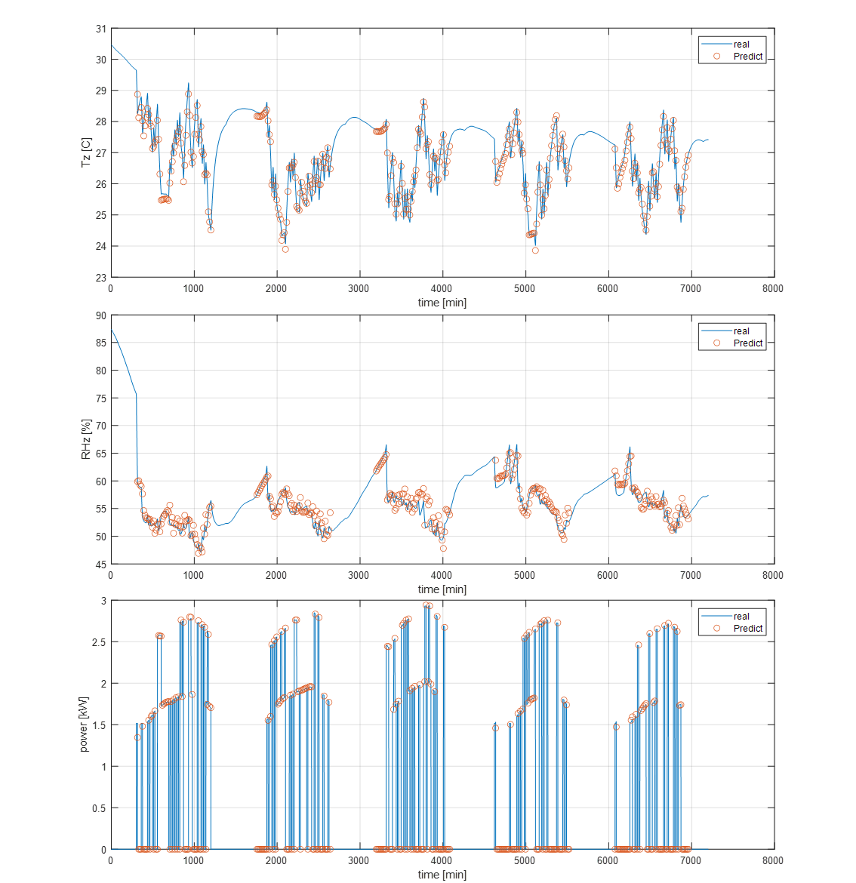
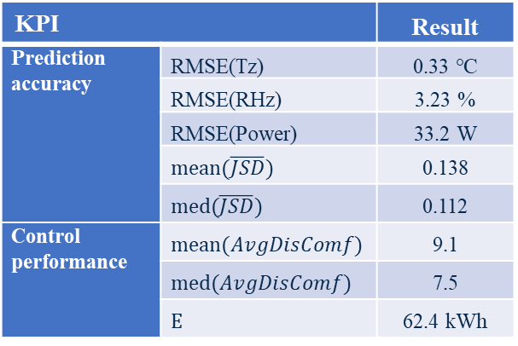
Task 4.3 Evaluation Results Analyze
The GOCC+TL MPC simulation results in15occ-N-3SP-4D evaluation case
Zone air temperature
HVAC system power
KPI |  | Result
Prediction accuracy | RMSE(Tz) | 0.33 ℃
 | RMSE(RHz) | 3.23 %
 | RMSE(Power) | 33.2 W
 | $$mean(\overline{JSD})$$ | 0.138
 | $$med(\overline{JSD})$$ | 0.112
Control performance | $$mean(AvgDisComf)$$ | 9.1
 | $$med(AvgDisComf)$$ | 7.5
 | $$E$$ | 62.4 kWh
Zone air relative humidity

Slide 49
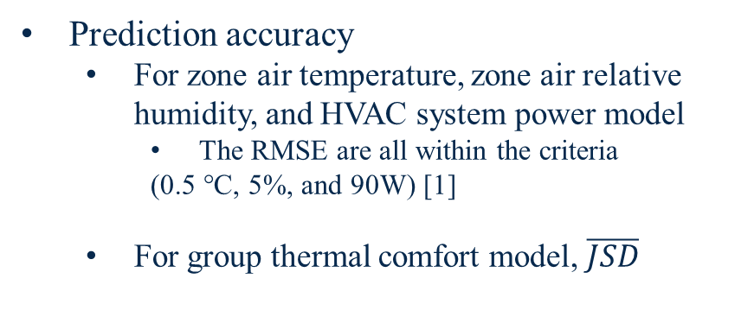
Task 4.3 Evaluation Results Analyze
Summary of the simulation results of 15occ-N-3SP-4D evaluation case
Prediction accuracy
For zone air temperature, zone air relative humidity, and HVAC system power model
The RMSE are all within the criteria
(0.5 °C, 5%, and 90W) [1]
For group thermal comfort model, $\overline{JSD}$
Control performance
For group thermal comfort, 𝐴𝑣𝑔𝐷𝑖𝑠𝐶𝑜𝑚𝑓
For HVAC system energy
[1] American Society of Heating, V., and Air Conditioning Engineers (ASHRAE), Guideline 14-2014, in Measurement of Energy and Demand Savings. 2014.

Slide 50
Task 4.3 Evaluation Results Analyze
Overall discussion
For occupant thermal comfort improvement
Poor accuracy in group thermal comfort model → Incorrect MPC’s prediction → Turn off HVAC system → Higher occupant discomfort vote
Good accuracy in group thermal comfort model → Correct MPC’s prediction → Reasonable system control → Less occupant discomfort vote
For energy saving
For the effective GOCC+TL MPC, energy saving depends on the group thermal preference
The effective GOCC+TL MPC can identify a suitable zone air temperature setpoint, and determine energy savings by comparison with the baseline.

Slide 51
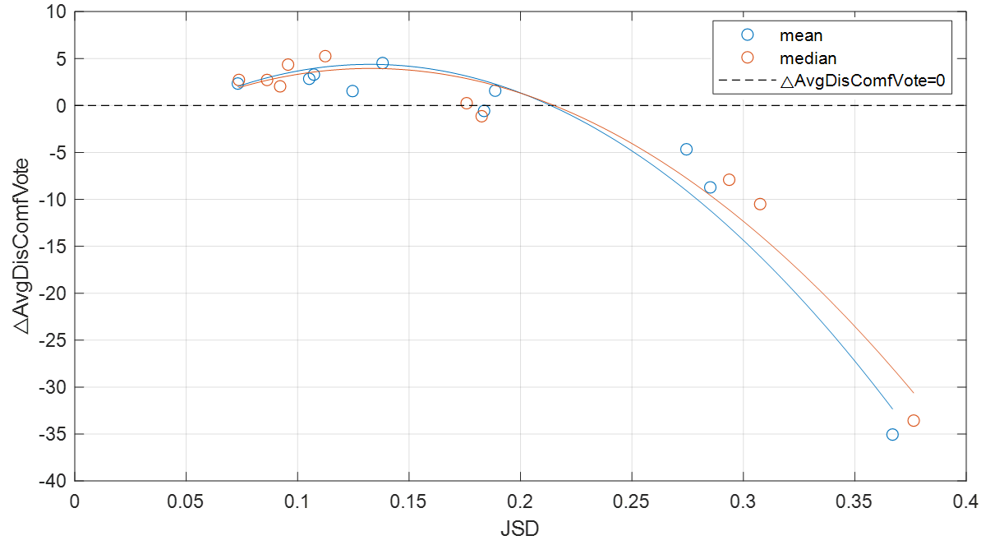
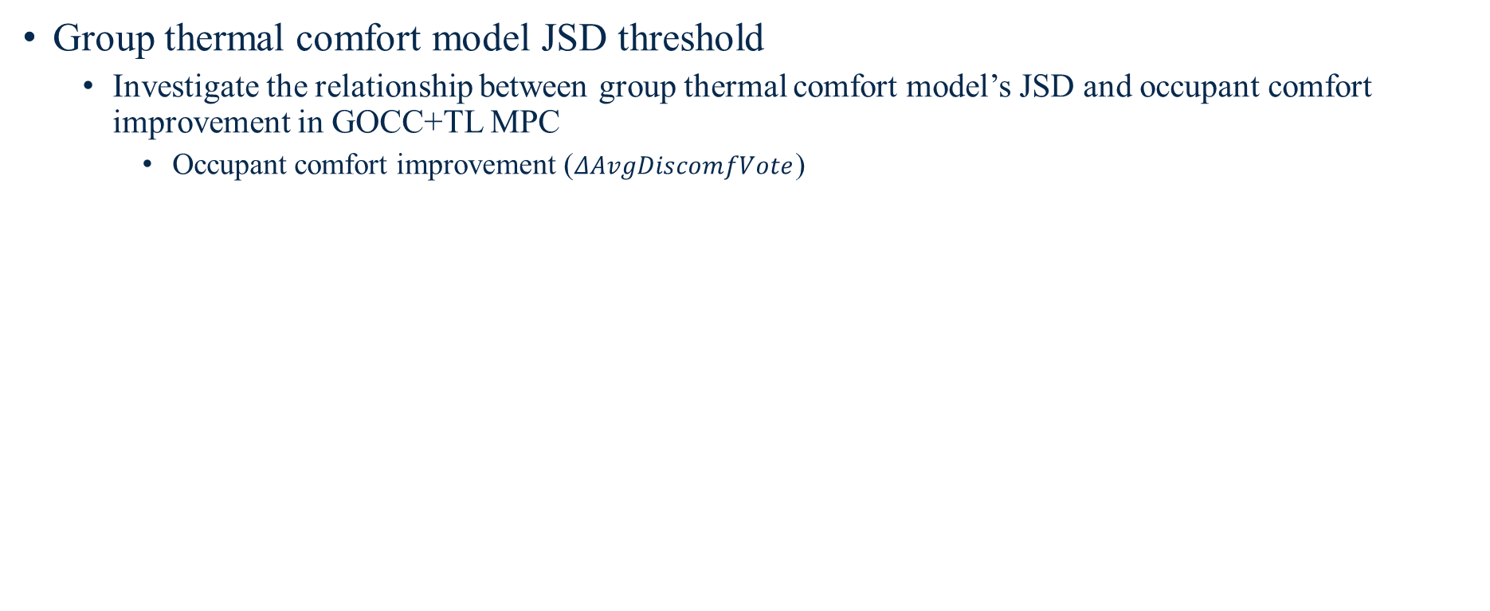
Task 4.3 Evaluation Results Analyze
Group thermal comfort model JSD threshold
Investigate the relationship between group thermal comfort model’s JSD and occupant comfort improvement in GOCC+TL MPC
Occupant comfort improvement ($ΔAvgDiscomfVote$)
$ΔAvgDiscomfVote={AvgDiscomfVote}_{temp−based MPC}−{AvgDiscomfVote}_{GOCC+TL MPC}$
The JSD threshold is inferred after quadratic curve fitting
Deduction: if JSD < 0.2, the proposed TMPC-GOCC strategy is expected to improve group occupant comfort
As a recommended criteria for group thermal comfort model development

Slide 52
Conclusions of Objective 4
Objective 4: Development and Evaluation of TMPC-GOCC
A framework of TMPC-GOCC is developed (task 4.1)
Three types of the MPC are designed for comparison (task 4.2)
Temperature-based MPC
GOCC-based MPC
GOCC+TL MPC (i.e., TMPC-GOCC)
Evaluation results demonstrate the advantages of the proposed TMPC-GOCC strategy in improving group thermal comfort. And the threshold of group thermal comfort model accuracy is determined (task 4.3)

Slide 53
Overall conclusion and future work
Conclusions
Future Works
Objective 1: Virtual Testbed Development
A virtual testbed, including ASHP, single zone, and occupant, is developed
Explore more evaluation scenarios by developing different testbeds
Objective 2: Predictive Model Development
Prediction models used in MPC are developed, including group thermal comfort model, zone environment model, and HVAC system power model
Explore category classification for group thermal comfort model in large-population cases
Objective 3: Transfer Learning Used in Group Thermal Comfort Model
The TL has strong applicability in improving predictive performance of the group thermal comfort model
Explore the optimization algorithm used in sample adaptation
Explore the effectiveness in more scenarios
Objective 4: TMPC-GOCC Development and Evaluation
TMPC-GOCC can improve occupant comfort when the group thermal comfort model is accurate
Explore an indicator to integrate building energy and occupant thermal comfort

Slide 54
Publication
Published Journal Papers
Li Y, Chen Z, Wen J, et al. A framework for calibrating and validating an HVAC system in Modelica[J]. Journal of Building Performance Simulation, 2025: 1-21.
Kimball R., Wen J., O’Neill Z., Li Y., et al. Developing Learning-Based Models for Occupant Centric Control[J]. 2022.
Calfa C, Yang Z, Li Y, et al. Performance assessment of a real water source heat pump within a hardware-in-the-loop (HIL) testing environment[J]. Science and Technology for the Built Environment, 2023, 29(10): 1011-1026.
Chen Z, Wen J, Li Y, et al. Advanced co-simulation framework for assessing the interplay between occupant behaviors and demand flexibility in commercial buildings[J]. Science and Technology for the Built Environment, 2024, 30(9): 1094-1113.
Published Conference Papers
Li Y., Chen Z, Wen J, et al. A framework for calibrating and validating an air loop dynamic model in an HVAC system in Modelica[C]. Proceedings of Building Simulation 2023: 18th Conference of IBPSA, Shanghai, CN, 2023.
Chen, Z., Wen, J., Li Y., et al., “A hardware-in-the-loop approach for laboratory performance verification of flexible building equipment in a typical commercial building”, ASHRAE Annual Conference, June 2021.
Chen, Z., Wen, J., Bushby, S. T., Lo, L. J., O’Neill, Z., Payne, W. V., Li Y., et al., “Development of a hardware-in-the-loop testbed for laboratory performance verification of flexible building equipment in typical commercial buildings”, ASHRAE Annual Conference, June 2022, Toronto, Ontario Canada.
Calfa, C., Yang, Z., Fu, Y., Chen, Z., O’Neill, Z., Wen, J., Li Y., et al., “Development of a water source heat pump hardware-in-the-loop (HIL) testing facility for smart building applications”, ASHRAE Annual Conference, June 2022, Toronto, Ontario Canada.
Chen, Z., Wen, J., Bushby, S. T., Lo, L. J., O’Neill, Z., Payne, W. V., Li Y, et al., “An analysis of the hybrid internal mass modeling approach in EnergyPlus”, eSim 2022 Conference, June 2022, Ottawa, ON.
Chen Z, Li Y, Wen J, et al. A simulation framework for analyzing the impact of stochastic occupant behaviors on demand flexibility in typical commercial buildings[C]//ASHRAE 2023 annual conference. 2023.
Calfa C., Yang Z., Li Y., et al. Performance Assessment of a Model Predictive Controller for a Heat Pump in a Hardware-in-the-Loop Experimental Test Environment. ASHRAE 2025 winter conference, Orlando, Florida, February 8-12, 2025.

Slide 55
Publication
Future publication plan
Li Y, Chen Z, Wen J. A framework of transfer learning used in group occupant thermal comfort model
Li Y, Chen Z, Wen J. Development of an MPC-based OCC with consideration of group occupant thermal comfort

Slide 56
Thank You
Yicheng Li
Building Science and Engineering Group (BSEG) | Drexel University
yl3328@drexel.edu

Slide 57
Backup

Slide 58
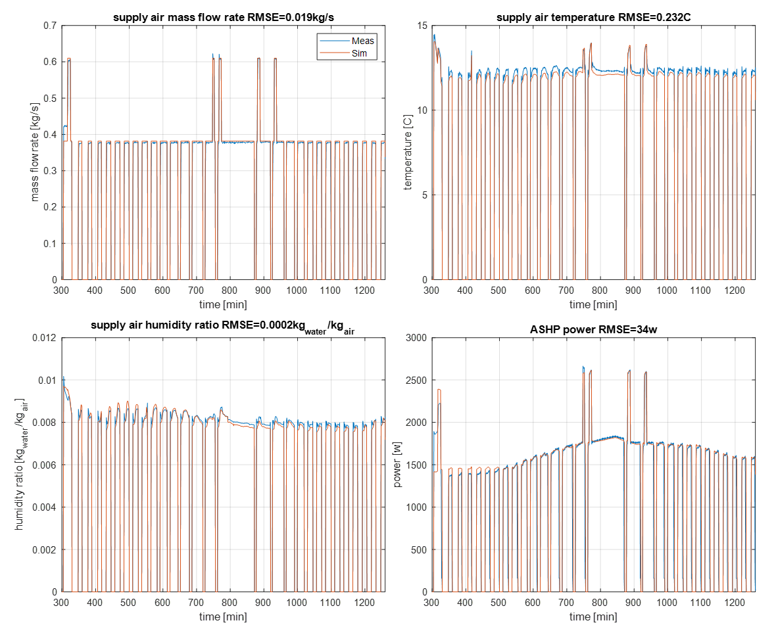
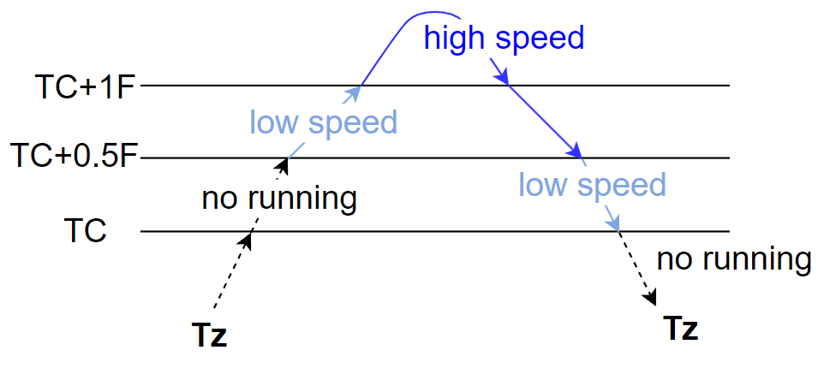
HVAC System Model: ASHP
Modeling method
System performance
Power and capacity curve is related to
zone air temperature
zone air dewpoint temperature
outdoor air temperature
The curve is obtained by quadratic curve fitting using experimental data
Back-calculate the supply air condition based on the return air condition and the system capacity
Controller

Slide 59
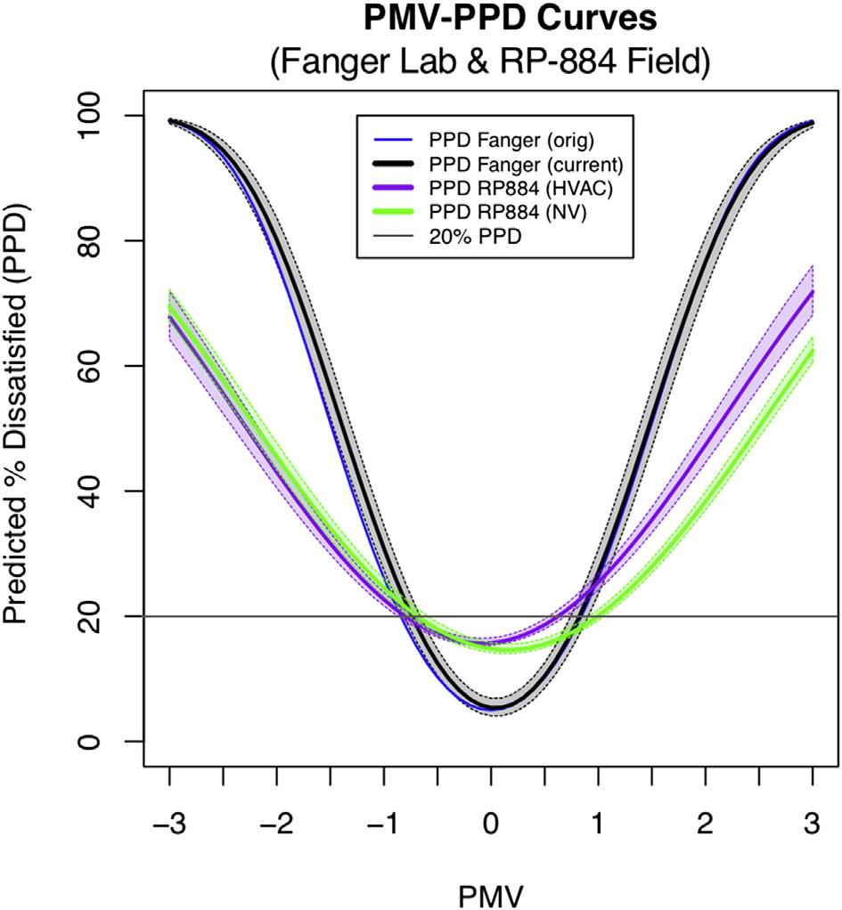
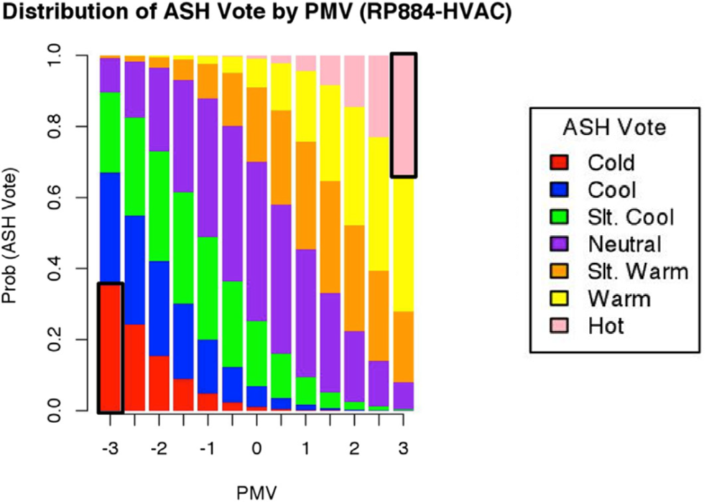
Occupant Comfort model

Slide 60
Task 1.1 HVAC System Model
HVAC system description
A two-stage Air Source Heat Pump (ASHP) at National Institute of Standards and Technology [1]
Model development
Model I/O
Input: zone and outdoor air condition, zone temperature setpoint (system speed mode)
Output: supply air condition and system power
Modelling method
Use second-order polynomial regression method and pervious experiment data [1, 2] to fit the system performance curve
Error
The CVRMSE in model outputs are all less than 5%.
ASHP schematic [1]
[1] Payne, W.V., S.H. Yoon, and P.A. Domanski, Heating mode performance measurements for a residential heat pump with single-faults imposed. 2017: US Department of Commerce, National Institute of Standards and Technology.
[2] Jin Wen, Z.C., et al., (2023), Hardware-in-the-loop Laboratory Performance Verification of Flexible Building Equipment in a Typical Commercial Building: Performance of Heating, Ventilation, and Air Conditioning and Thermal Energy Storage Across the United States, National Institute of Standards and Technology, https://doi.org/10.18434/mds2-3058

Slide 61
Task 1.2 Zone Model
Zone model description
A typical small office EnergyPlus model from the Commercial Prototype Building Models [1]
A south-facing room was chosen as the simulated zone.
Model adaptation
Export as a Functional Mockup Unit (FMU) [2]
Model I/O
Input: supply air condition
Output: zone air condition
Small office floor plan
[1] U. S. DOE. Commercial Prototype Building Models. Available: https://www.energycodes.gov/development/commercial/prototype_models
[2] EnergyPlusToFMU, L.B.N. Laboratory, Editor. 2109, Lawrence Berkeley National Laboratory: https://simulationresearch.lbl.gov/.

Slide 62
Task 1.3 Occupant Thermal Comfort Model
Original model description
Agent-based model for occupant’s comfort and behaviors [1]
Initialize virtual occupants with personal characteristics
Thermal acceptability range
Behavior constraint
Based on environmental conditions, stochastically simulate:
Occupant’s thermal sensation and comfort
Occupant’s behavior
Model adaptation
Simulate occupant thermal comfort only
Model I/O
Input: zone air condition
Output: occupant’s comfort vote
Diagram of the agent-based occupant model [1]
[1] Langevin, J., J. Wen, and P.L. Gurian, Modeling thermal comfort holistically: Bayesian estimation of thermal sensation, acceptability, and preference distributions for office building occupants. Building and Environment, 2013. 69: p. 206-226

Slide 63
Group thermal comfort model
Model evaluation
Goal:
Trying to ensure that the model prediction can have a close probability distributions compared with the real value under different environments.
Considering follow-up transfer learning, the similarity of the two probability distributions needs to be quantified to evaluate the performance of transfer learning.
Method: 5-fold cross-validation
Typical method to evaluate the performance of a classification model:
Instance-based: confusion matrix (includes accuracy, precision, recall, F1 score, ROC-AUC…)
Probability-based:
Statistical test: T test, K-S test, Chi-Square test
Similarity measures: Jensen-Shannon Divergence (JSD), Earth Mover's Distance (EMD), logistic loss
Probability-based method
Differential method
Similarity measurement

Slide 64
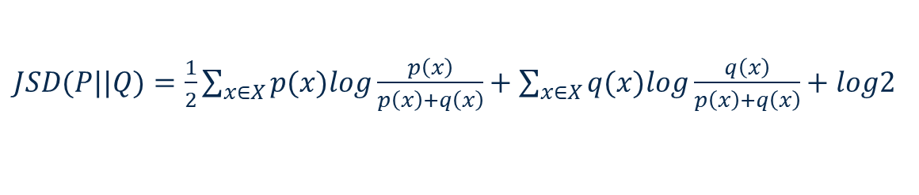


JSD Calculation
Error evaluation
Process
Divide the entire feature space into several subspaces
0.5 C for the feature related to temperature [1]
5% for the feature related to relative humidity
Calculate the JSD in each subspace
Calculate the weighted average JSD
Weighted mean JSD calculation schema
$JSD(P||Q)=\frac{1}{2}\sum_{x∈X}{p(x)log\frac{p\left(x\right)}{p\left(x\right)+q\left(x\right)}}+\sum_{x∈X}{q(x)log\frac{q\left(x\right)}{p\left(x\right)+q\left(x\right)}}+log2$
Where:
P and Q: p(x) and q(x), the two probability distributions in sample space X;
n is the number of sample in the space.
$\overline{JSD}=\sum_{i=1}^{n}{w_{i}JSD_{i}}$
$$w_{i}=\frac{n_{i}}{n_{total}}$$
[1] Battistel, L., et al., An investigation on humans’ sensitivity to environmental temperature. Scientific Reports, 2023. 13(1): p. 21353.

Slide 65
The smallest RH difference
PMV vs RHz
PPD vs RHz
In typical office condition
Air temperature=26 C
Air speed=0.1 m/s
Mean radiant temperature=28C
Clothing level=0.6 clo
Metabolic rate =1.2 met
For every 4% increase in humidity, the PPD increases by 1%

Slide 66
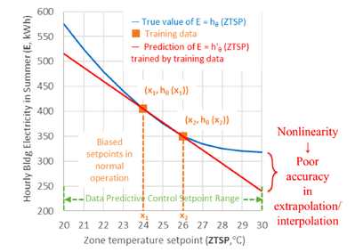
Active Learning

Slide 67
Model Prediction Error
Candidate learning algorithms | Candidate Prediction Horizons
 | ph=1 | ph=2 | ph=4 | ph=8
ANN | 0.35 | 0.48 | 0.72 | 1.12
RNN | 0.08 | 0.13 | 0.21 | 0.28
MLR | 1.31 | 1.54 | 2.06 | 3.12
MARS | 0.12 | 0.85 | 1.97 | 2.64
Candidate learning algorithms | Candidate Prediction Horizons
 | ph=1 | ph=2 | ph=4 | ph=8
ANN | 1.48 | 3.26 | 5.73 | 8.59
RNN | 3.47 | 5.82 | 8.36 | 11.09
MLR | 5.63 | 9.27 | 13.58 | 18.94
MARS | 1.51 | 2.74 | 4.74 | 8.12
Zone air temperature prediction error (RMSE) [°C]
Zone air relative humidity prediction error (RMSE) [%]
Candidate learning algorithms | Candidate Prediction Horizons
 | ph=1 | ph=2 | ph=4 | ph=8
ANN | 62 | 65 | 71 | 79
RNN | 62 | 74 | 86 | 98
MLR | 81 | 95 | 122 | 148
MARS | 64 | 69 | 75 | 88
HVAC system power prediction error (RMSE) [W]

Slide 68
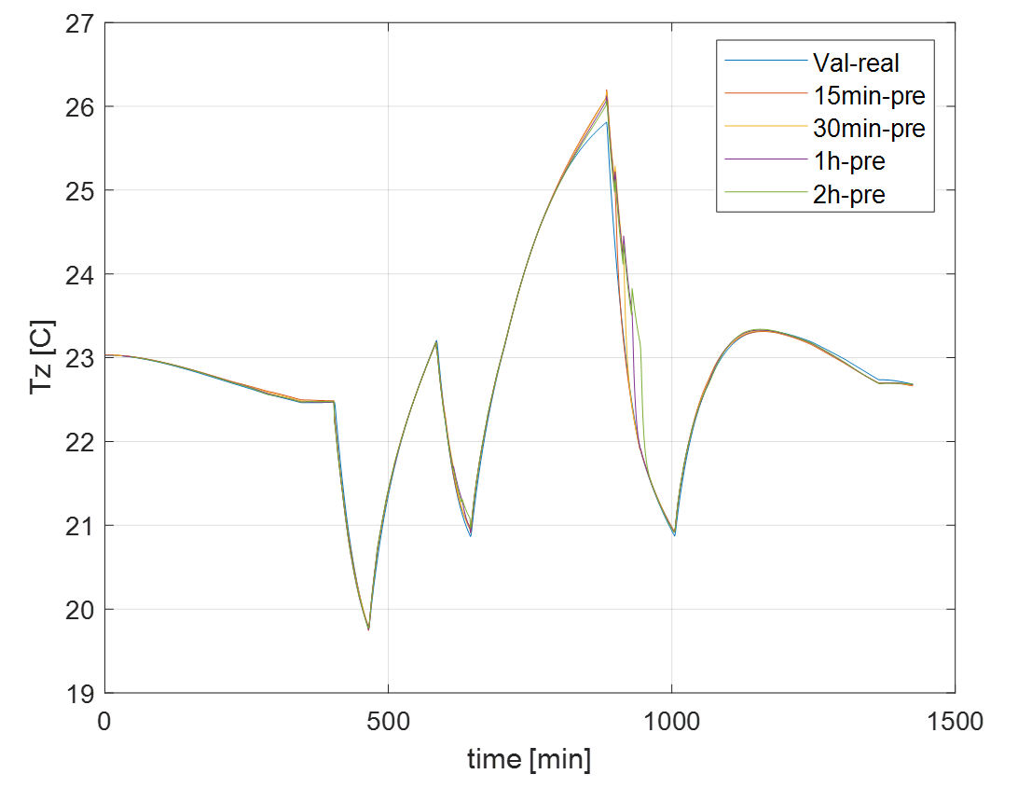
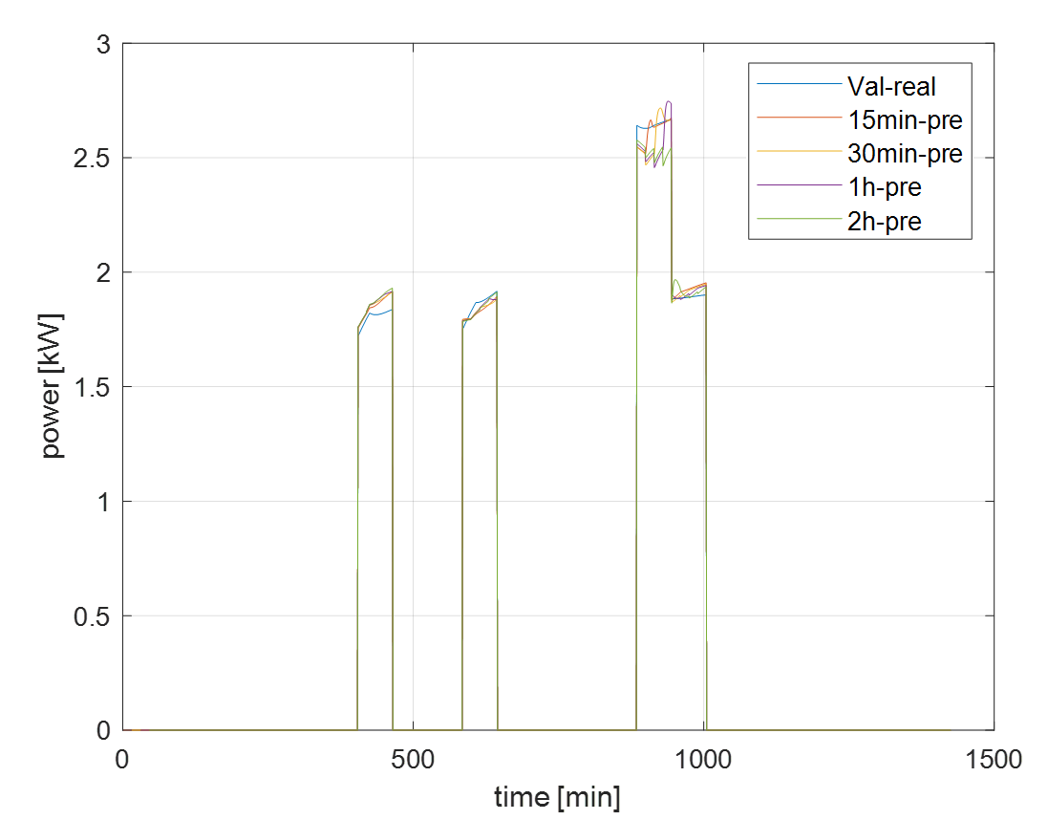
Model Prediction Error

Slide 69

Task 2.2 Zone Environment and HVAC System Power Model Development
Validation goal
Determine model structure
Determine the prediction horizon for MPC
Validation index
Root Mean Square Error (RMSE)
Validation results
PH selection
PH=4, based on the typical criteria (0.5 °C for temperature, 5% for relative humidity, and 90W for HVAC system power [1])
Model structures selection and error
Zone air temperature RNN model: 0.21 °C
Zone air relative humidity MARS model: 4.74%
HVAC system power ANN model: 71W
$$RMSE= \sqrt{\frac{\sum_{i=1}^{N}{{\left(y_{i}−ŷ_{i}\right)}^{2}}}{N}}$$
[1] American Society of Heating, V., and Air Conditioning Engineers (ASHRAE), Guideline 14-2014, in Measurement of Energy and Demand Savings. 2014.
Notes:
After comparing the validation error of the model developed by different model structures, the suitable model structures can be selected.
Another thing needed to be determined is the prediction horizon. Because at the end, this study will develop an MPC strategy, which involves the prediction in multiple step. So, how long the prediction horizon can be also need to de determined.
The validation index is Root Mean Square Error.
And after checking the validation results, based on the criteria on Guideline 14, I select that the PH=4.
As for the model structures, the zone air temperature use RNN model, zone air relative humidity model use MARS model, and the HVAC system model use ANN model. The error of each model is also provided. They are all with in the criteria.

Slide 70
Task 3.2 Evaluation Scenarios Design
Goal:
Evaluate the feasibility of the proposed TL framework
Method:
Design different scenarios to determine whether the TL are effective
Source domain design
Source domain data is the simulation data from virtual testbed
One super-rich dataset covers a wide range of environmental conditions and occupant profiles
Target domain design
Target domain data is the “real data” obtained by using virtual testbed to represent the real building
Design different scenarios to mimic the data that could be collected in real life

Slide 71
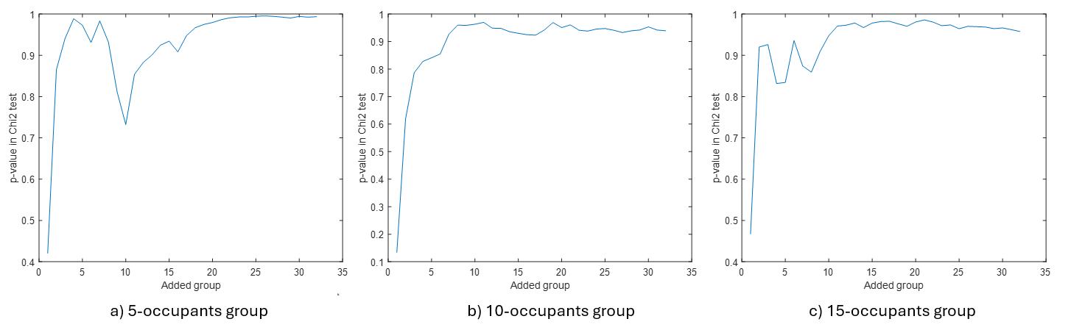
Task 3.2 Evaluation Scenarios Design
The source domain data contains 3 different numbers of people (5, 10, and 15)
Zone area = 113 m²
Minimum area per occupant = 7.4 m² [1]
24 groups of each population size (thermal acceptability is sampled by RP-884)
The chi-square test [2] is used to determine the goodness-of-fit of two distributions (PMV-PDD curve in RP-884 and the curve in source domain)
Criteria: p-value =0.95
1-month simulation with random setpoint (65°F ~85°F)
[1] Voss, J., Revisiting office space Standards. Grand Rapids, MI: Haworth, 2000: p. 1-6

Slide 72







Chi-square Test
Method: A typical method to test the goodness-of-fit of two distributions is the chi-square test [1].
$$E_{i1}=\frac{\left(O_{i1}+O_{i2}\right)×N_{1}}{N}$$
Where:
$O_{i1}$ and $O_{i2}$ are the number of observation in category 𝑖 in distribution 1 and 2, respectively.
$N_{1}$, $N_{2}$, and $N$ are the number of samples in distribution 1, 2, and total, respectively.
$E_{i1}$ and $E_{i2}$ are the expected counts of observation 𝑖 in the distribution 1 and 2, respectively.
$k$ is the number of the category, which is 7 in this study (PMV=-3:3).
$x_{1}^{2}$, $x_{2}^{2}$, and $x^{2}$ are the chi-square test statistic of distribution 1, 2, and total.
$$E_{i2}=\frac{\left(O_{i1}+O_{i2}\right)×N_{2}}{N}$$
$$x_{1}^{2}=\sum_{i=1}^{k}{\frac{{\left(O_{i1}−E_{i1}\right)}^{2}}{E_{i1}}}$$
$$x_{2}^{2}=\sum_{i=1}^{k}{\frac{{\left(O_{i2}−E_{i2}\right)}^{2}}{E_{i2}}}$$
Based on $x^{2}$ and the degrees of freedom (7-1=6) , a p-value can be calculated. Typically:
If the p-value < 0.05, the two distributions can be considered significantly different.
If the p-value > 0.95, the two distributions can be considered similar.
$x^{2}=x_{1}^{2}$+ $x_{2}^{2}$
[1] Abramowitz, Milton, and Irene A. Stegun, eds. Handbook of Mathematical Functions: With Formulas, Graphs, and Mathematical Tables. 9. Dover print.; [Nachdr. der Ausg. von 1972]. Dover Books on Mathematics. New York, NY: Dover Publ, 2013.

Slide 73





Information Entropy
Where:
$A$ is the feature and outcome matrix
$λ=[{λ_{1}, …,λ}_{n}]$is the eigenvector
$P_{i}$ is the normalized eigenvalue
$H$is the information (eigen) entropy
$$A=\left[\begin{matrix}a_{11} & ⋯ & a_{1n} \\ ⋮ & ⋱ & ⋮ \\ a_{m1} & ⋯ & a_{mn}\end{matrix}\right]$$
$$P_{i}=\frac{\left|λ_{i}\right|}{\sum_{j=1}^{n}{\left|λ_{j}\right|}}$$
$$H=−\sum_{i=1}^{m}{P_{i}}\log_{2}(P_{i})$$
Information entropy varies with the time period of data collection

Slide 74

TL evaluation results

Slide 75

Task 4.1 MPC Framework Development
Three types of MPC
Temperature-Based MPC
GOCC-Based MPC
The group thermal comfort model is trained without transfer learning
GOCC+TL MPC (TMPC-GOCC)
The group thermal comfort model is trained with transfer learning
Flowchart of the development process of the three MPCs

Slide 76
Task 4.1 MPC Framework Development
$$min⁡J\left(x\right)=\sum_{t}^{PH}{{Power}_{15∗t}}×Δt$$
Objective function:
Where:
$Δt$ is prediction timestep, 15 min; PH is prediction horizon, 4;
x is the control variable, i.e., HVAC system speed mode;
Optimization algorithm: Exhaustive method
[1] ANSI/ASHRAE Standard 55-2020, Thermal Environmental Conditions for Human Occupancy, 2020

Slide 77
MPC Model Predictive Error
 | 5occ-N-3SP-5D |  |  | 15occ-N-3SP-5D |  |  | 7occ-N-3SP-5D |  |  | 15occ-N-3SP-4D |  |  | 5occ-N-3SP-4D
 | Tz [C] | RHz [%] | power [W] | Tz [C] | RHz [%] | power [W] | Tz [C] | RHz [%] | power [W] | Tz [C] | RHz [%] | power [W] | Tz [C] | RHz [%] | power [W]
Temperature-based | 0.2 | 1.51 | 24.5 | 0.26 | 1.56 | 14.5 | 0.09 | 0.16 | 21.1 | 0.26 | 1.56 | 14.5 | 0.2 | 1.51 | 24.5
GOCC-based | 0.21 | 2.86 | 5.5 | 0.4 | 1.52 | 43.5 | 0.41 | 1.16 | 31 | 0.26 | 1.88 | 11.8 | 0.33 | 4.42 | 37.3
GOCC+TL | 0.24 | 1.71 | 17 | 0.28 | 1.67 | 20.5 | 0.21 | 2.61 | 5.2 | 0.33 | 3.23 | 33.2 | 0.36 | 4.21 | 47.9
 | 15occ-N-3SP-1D |  |  | 15occ-N-3SP-3D |  |  | 7occ-N-3SP-3D |  |  | 5occ-C-3SP-5D |  |  | 7occ-N-3SP-2D
 | Tz [C] | RHz [%] | power [W] | Tz [C] | RHz [%] | power [W] | Tz [C] | RHz [%] | power [W] | Tz [C] | RHz [%] | power [W] | Tz [C] | RHz [%] | power [W]
Temperature-based | 0.26 | 1.56 | 14.5 | 0.26 | 1.56 | 14.5 | 0.09 | 0.16 | 21.1 | 0.2 | 1.51 | 24.5 | 0.09 | 0.16 | 21.1
GOCC-based | 0.26 | 1.2 | 16.4 | 0.28 | 3.03 | 20.7 | 0.43 | 2.69 | 44.2 | 0.44 | 2.66 | 15.7 | 0.23 | 2.68 | 6.8
GOCC+TL | 0.37 | 2.53 | 23.7 | 0.29 | 2.95 | 22.8 | 0.27 | 1.58 | 25 | 0.25 | 1.63 | 12.5 | 0.36 | 3.11 | 29.5
Criteria: 0.5 °C, 5%, and 90W [1]
[1] American Society of Heating, V., and Air Conditioning Engineers (ASHRAE), Guideline 14-2014, in Measurement of Energy and Demand Savings. 2014.

Slide 78
MPC Evaluation Result of JSD

Slide 79
Occupant Average Discomfort Vote

Slide 80




















Energy Use

Slide 81




Group Thermal Comfort MPC Predicted Results vs Testbed Simulation Results
GOCC-based MPC case
GOCC+TL MPC case
MPC predicted
MPC predicted
MPC predicted
a) 15occ-N-3SP-4D GOCC-based MPC case MPC predicted group thermal comfort
a) 15occ-N-3SP-4D GOCC+TL MPC case MPC predicted group thermal comfort
Real
Real
b) 15occ-N-3SP-4D GOCC+TL MPC case simulated group thermal comfort
b) 15occ-N-3SP-4D GOCC-based MPC case simulated group thermal comfort

Slide 82

Group Occupant thermal Preference

Slide 83
JSD Threshold

